Slide 1
Aero 101 for R/C Pilots Part 1
Brian D. Kelly
June 2017

Slide 2
Common Questions from RC Pilots
Part 1 (June 2017)
Before takeoff
Will this plane be stable?
Takeoff
How does the prop affect the airplane?
Do I need right thrust?
Wind
Is the “downwind turn” a myth?
Cruise
How to fine-tune the cg
Do I need down thrust?
General Handling
Plane snaps out of a tight turn
Does dihedral help or hinder me?
Won’t respond to aileron when slow
Unstable or too sensitive?
Part 2 (Feb 2018)
Approach
How can I slow down safely?
Should I re-trim for approach?
Use elevator or thrust?
What will flaps do?
Judge what a new plane will be like
Wing Loading and stall speed
Power loading
Aspect Ratio
Servo size
Part 3
How can I use my computer transmitter to make the airplane more enjoyable or easier to fly?

Slide 3
Before takeoff Will this new plane be stable?
Where should I put the cg?
Ahead of the center of lift.
Where is the center of lift?
How much ahead of the center of lift?
Is the tail big and/or long enough?

Slide 4
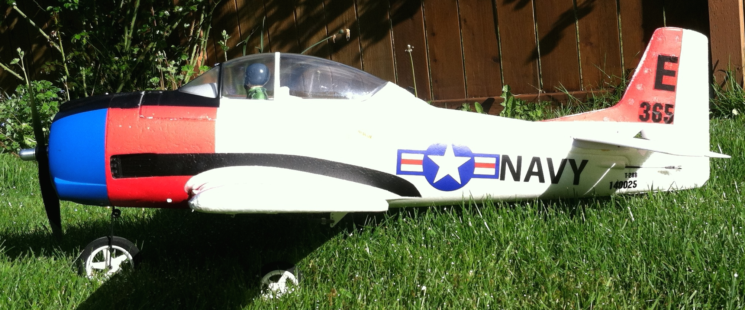
Centers of Lift and Gravity Determine Pitch and Speed Stability
LIFT
Small
Down
Force
WEIGHT
Center of
Gravity (CG)
Balance Point
Center of Lift
about 25% of Mean Aerodynamic Chord (MAC)
About 10-20% MAC for stability
Can be aft of center of lift for aerobatics
Too far aft, and the “neutral point is reached (truly unstable)

Slide 5
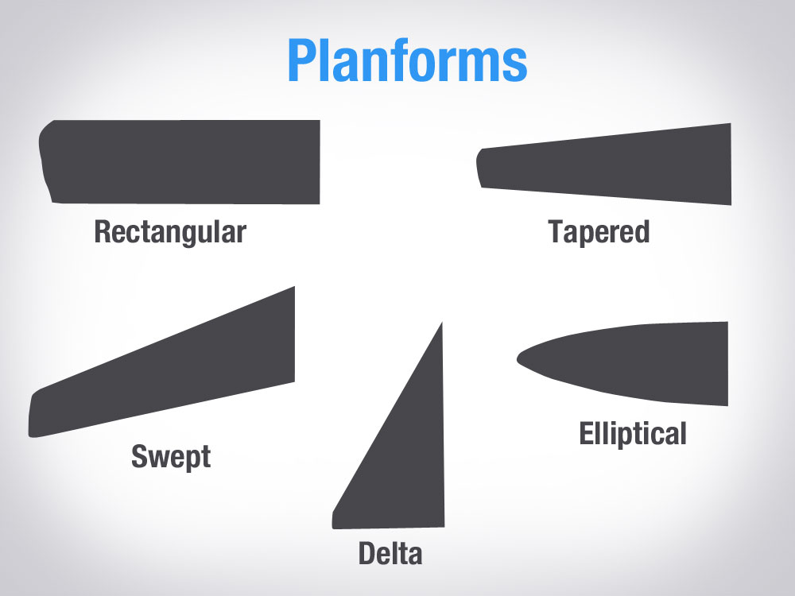
Where’s the Center of Lift?
?

Slide 6
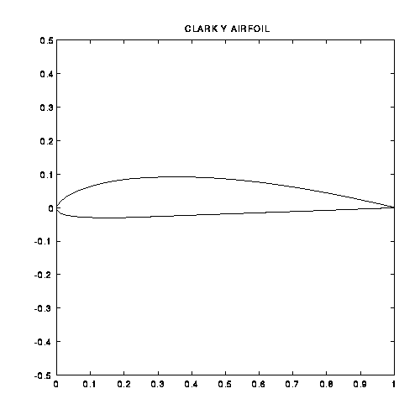
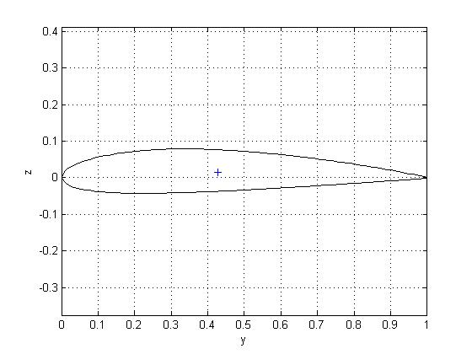
Airfoil Shapes
Flat bottom airfoil
More camber (mid-line is curved)
Trainers and Cubs (Clark Y)
Good at low speeds
“Semi-symmetrical” airfoil
has some camber
sometimes used on trainers
Good all-around airfoil
Symmetrical airfoil
Zero camber - mid line is straight
Used on aerobatic airplanes
Center of lift is very close to 25% chord for almost any airfoil (subsonic)
-- usually near max thickness, best place to put the spar.
Notes:
WING SECTION.
Wing section, or airfoil, is the term used to describe the geometric shape of a cross section of the wing in the fore and aft plane. Wing Sections are assigned names by their developers, for instance, the wing section called NACA 2412 is just one of the many developed by the National Advisory Committee for Aeronautics, a US Federal Government agency now part of NASA.
Wing Sections are all geometric variations of a streamlined teardrop shape. Sometimes they are fully symmetrical, meaning that they do not have camber. Camber is the term used to describe any curvature of a midpoint line joining the extreme points of the wing section at the leading and trailing edges.
Model aircraft designers frequently choose Wing Sections from a vast array available from many sources, such as NASA, rather than develop their own Wing Sections. The Airfoil Section mentioned above, NACA 2412, is a very widely used section. It is one of NASA's four digit series, where the first digit, 2, indicated that the section has camber of 2% of total depth. Second digit, 4, indicates maximum camber located at 40% of the chord. The last two digits indicate airfoil maximum thickness, 12%.
Wing sections are selected by the model designer to suit the intended use and flight characteristics of the model. The aerodynamic characteristics of most wing sections are described mathematically in a series of graphs commonly known as Lift/Drag graphs, or L/D curves. These graphs are the result of wind tunnel tests. As the name implies, these graphs plot the lift coefficient produced by the subject wing section against the induced drag and pitching moment coefficients as the angle of attack is varied.
At any specified airspeed and angle of attack the lift of the subject wing may be calculated using the Lift Coefficient from the L/D graph in a series of mathematical expressions. Similarly the Induced Drag, which is the resisting force resulting from the Lift generated by the wing having the subject Section at a particular airspeed and angle of attack, may be calculated.
Model designers typically choose fully symmetrical wing sections for aircraft intended for aerobatics. Such wing sections are equally effective inverted as they are upright. Model aircraft intended for less inverted flight generally use airfoils having some camber as such airfoils generate higher lift coefficients than do symmetrical airfoils at positive angles of attack.
Section thickness is another variable. Thin sections have lower induced drag than thicker sections, all other factors being equal. Practically, for RC model use,
a reasonably thick wing section between 10 and 14 percent of chord provides for adequate depth of spar, (to resist imposed loads in flight), and ease of construction. Thinner wings are used for high speed applications where low drag is important, such as pylon racers or turbine powered aircraft.

Slide 7
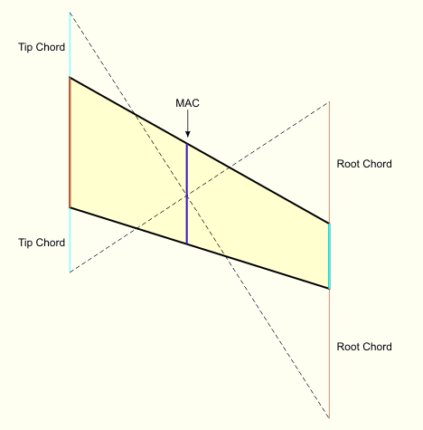
Mean Aerodynamic Chord (MAC)
A chord location equivalent to a rectangular wing of the same area
Center of Gravity (balance point) should be 10-20% of MAC ahead of the Center of Lift *
Center of lift is at 25% of MAC from leading edge
Graphical method to find MAC on a swept and tapered wing
* with fuel tank empty if fuel tank is forward of CG

Slide 8
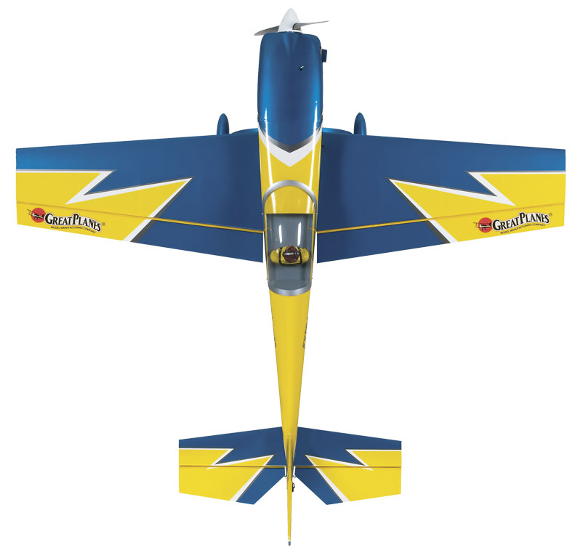
Is the horizontal tail big or long enough?
Even if CG is right, too small or too short tail:
difficult to fly
sensitive to CG position
Tail Volume takes tail length and area into account
S_{h} L_{h}
V_{h} =
S c
V_{h} horizontal tail volume
S_{h} horizontal tail area (includes elevator)
L_{h} tail length: .25 mac wing to to .25mac of horizontal
S wing area
c is mean aerodynamic chord (mac)
V_{h} should be from 0.3 to 0.6 for full scale planes
(generally more for RC planes, much more for a pattern plane)
Compare your plane to one of similar size with known flying characteristics

Slide 9
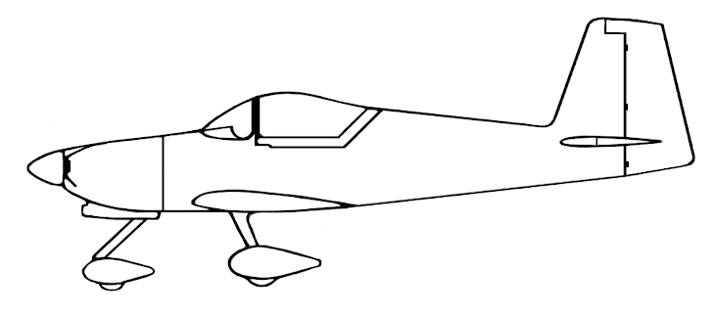
Is the vertical tail big or long enough?
Even if CG is right, too small or too short tail:
difficult to fly
sensitive to CG position
Tail Volume takes length and area into account
S_{v} L_{v}
V_{v} =
S b
V_{v} vertical tail volume
S_{v} vertical tail area (includes rudder)
L_{v} tail length: .25 mac wing to to .25mac of vertical area
S wing area
b wing span
V_{v} should be from 0.02 to 0.05 for full scale planes (generally more for RC planes)
Compare your plane to one of similar size with known flying characteristics
https://ocw.mit.edu/courses/aeronautics-and-astronautics/16-01-unified-engineering-i-ii-iii-iv-fall-2005-spring-2006/systems-labs-06/spl8.pdf

Slide 10
Takeoff
How does the prop affect the airplane?
Do I need right thrust?
Wind
Is the “downwind turn” a myth?

Slide 11
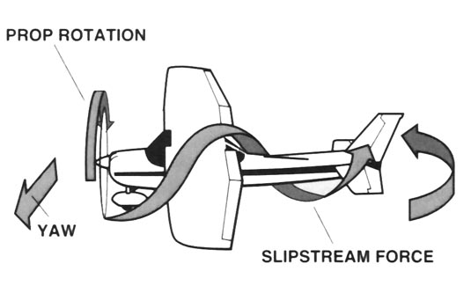
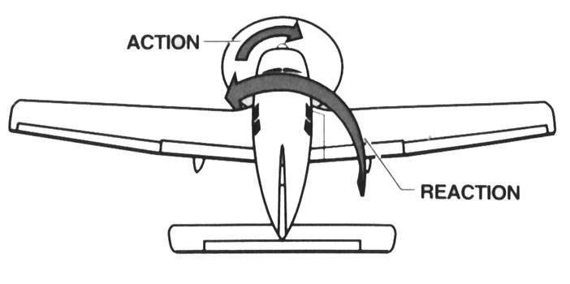
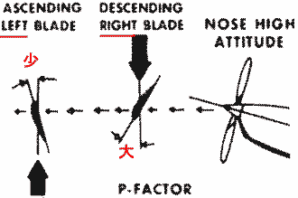
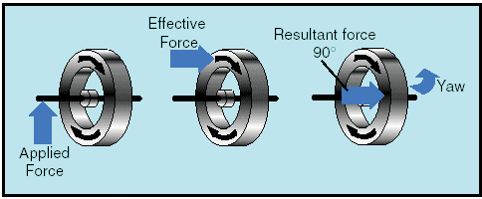
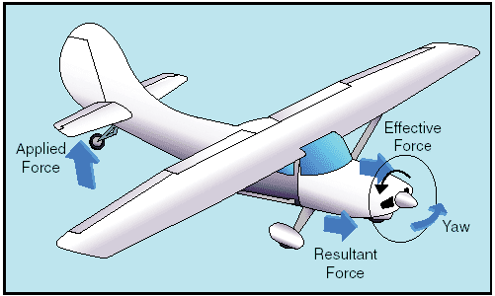
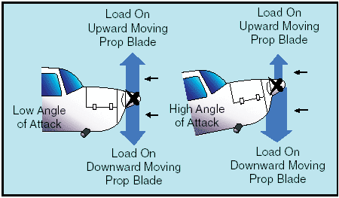
Propeller effects in Roll and Yaw
Slipstream (Likely the largest effect)
Torque
P-factor
Gyroscopic Precession
http://www.free-online-private-pilot-ground-school.com/propeller-aerodynamics.html
https://www.aircraftspruce.com/catalog/pdf/13-09032.pdf

Slide 12
Propeller Effects
What the pilot experiences
Swirling slipstream hits vertical fin | Yaw Left* | - noticeable on early takeoff roll
Gyroscopic effects | Yaw Left* | - Early takeoff when taildragger lifts up tail
Torque | Roll left | large prop and short span Torque roll hanging from prop - not noticeable if gear on the ground
“p-factor” | Yaw left* | noticeable in the air with aoa on ground for taildragger in tail-down position
* Sudden left yaw in the air will also cause left roll if airplane has dihedral

Slide 13
Right Thrust
Helps!
Must experiment for your airplane
Most ARF’s come with the right thrust built in
Start with a couple washers under the left engine mount bolts
Do the experimenting before final mounting of your cowl

Slide 14
The Downwind Turn
Path over ground with wind. High ground speed
Path over ground - No wind
Wind
The airplane doesn’t “feel” a steady wind
If pilot controls by reference to the ground (not instruments) can pitch up too much and stall by perceiving ground speed
RC pilots stand on the ground and therefore tend to reference their airplane control relative to the ground
Down-wind turn hazards are a real thing for RC pilots

Slide 15
Wind on Takeoff
Takeoff into the wind….of course!
Crosswind will cause:
Yaw into the wind
Upwind wing to pick up, esp for high wing with dihedral
Example: Crosswind from the right
Causes right yaw initially
Causes left roll as you rotate into the air (if dihedral)
Prop effects also cause left turn
Can lead to a downwind turn at low altitude

Slide 16
Cruise
How to fine-tune the cg
Do I need down thrust?

Slide 17
Centers of Lift and Gravity Determine Pitch and Speed Stability
LIFT
Small
Down
Force
WEIGHT
Center of
Gravity (CG)
Balance Point
Center of Lift
(about 25% of MAC)
About 10-20% MAC for stability
Can be at or slightly aft of center of lift for aerobatics (neutral stability)
Too far aft, and the “neutral point” is reached (truly unstable)

Slide 18
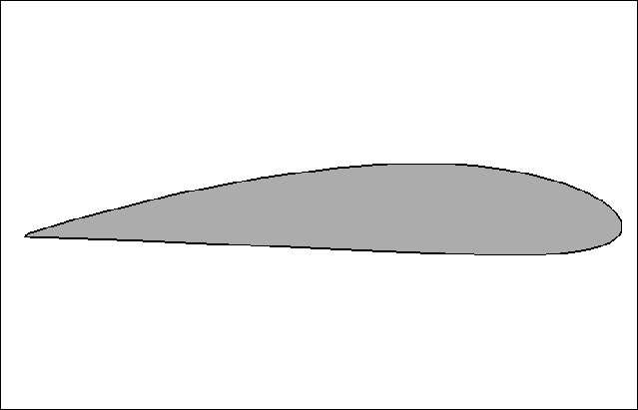
Trimmed
L
Airspeed
d
(Tail down-force)
W

Slide 19
Now, increase speed without re-trimming
L
Increased
Airspeed
Tail down-force
W
More lift
More tail down-force
Weight stays the same
Airplane climbs, and pitches UP
… airplane begins to decelerate
Speed decreases ...

Slide 20
Decrease speed from trimmed state
L
Airspeed
Tail down-force
W
Less lift
Less tail down-force
Weight stays the same
Descends and pitches down
… Airplane begins to accelerate
... Speed increases
... Cycle begins again

Slide 21
Result? Phugoid
Airplane is seeking the trimmed speed – “speed stable”
Small, relatively slow changes. Pilot corrects without knowing
Undesirable for aerobatics
https://en.wikipedia.org/wiki/Aircraft_dynamic_modes

Slide 22
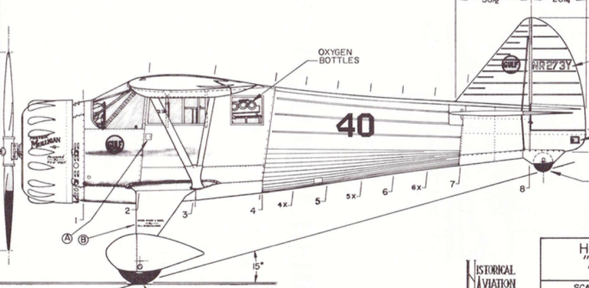
Fine-Tuning the CG (Choosing your Speed Stability)
Trim for mid-power
Fly high and level
Nose down about 45º
Hands off controls
Let airplane accelerate
Speed increases
Trim speed
Speed stable
(nose heavy)
Not speed stable (tail heavy)
Neutral
(for aerobatics)
Another way:
http://www.flyrc.com/aerobatic-trimming/

Slide 23
Down-Thrust compensates for pitch changes due to increase in speed from throttle
L
Engine thrust
Down
force
Airplane thrust
d
(Tail down-force)
W
… and reduces the need to re-trim
at approach speed

Slide 24
General Handling
Snaps or spins out of a tight turn
Does dihedral help or hinder me?
Won’t respond to aileron when slow
Unstable or too sensitive?

Slide 25
Snaps or Spins out of a Tight Turn
Stall
Stall with G’s
How many G’s in a turn?
Why does it Snap? (one wing stalls first)
Wings at different incidence
Torque (if highly powered)
Wing planform stall characteristics
Airfoil stall characteristics
Reynolds number
Washout and other preventive measures

Slide 26
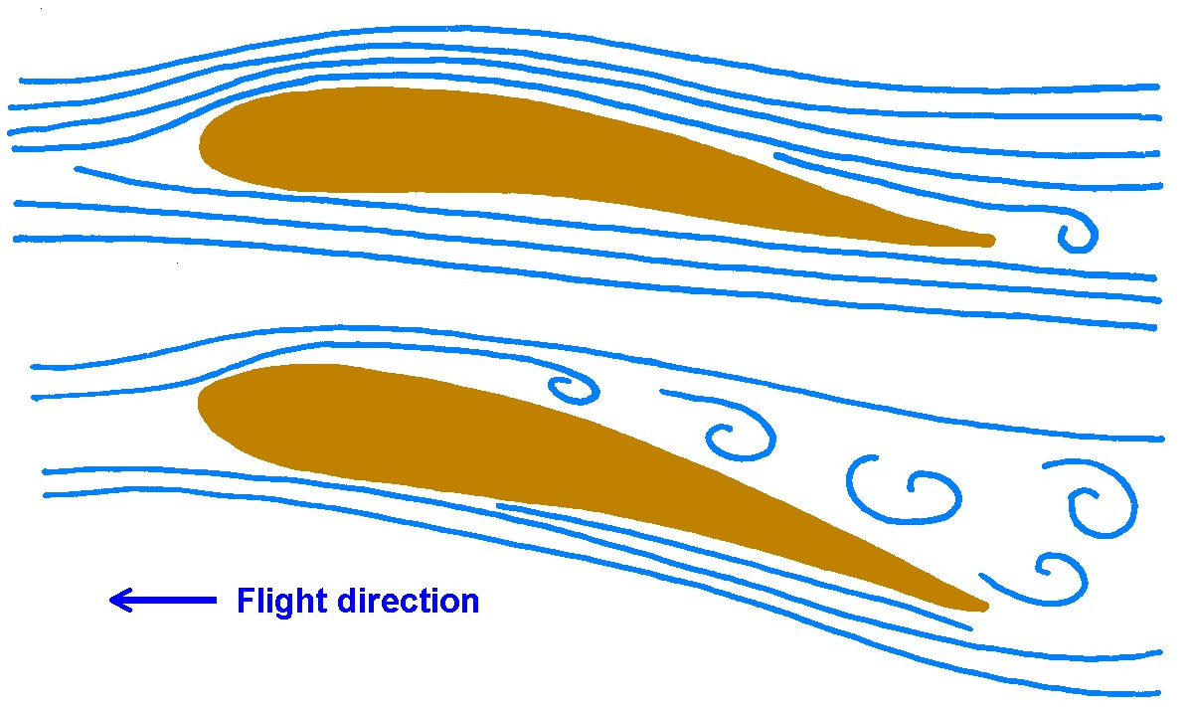
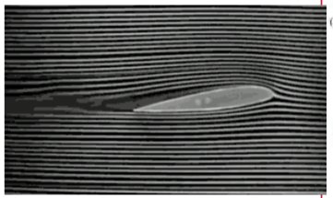
Lift is reduced when the Wing Stalls
Flow separation occurs at the critical angle of attack, around15 degrees, depending on
thickness
camber
LE radius
wing planform
Critical angle of attack can occur when:
Too slow
Too many g’s
Or both
…in any attitude
Notes:
THE STALL
AN ACCIDENT
The RC model aircraft, a warbird scale model of fairly high wing loading, is on the downwind leg of a left hand landing pattern, flying with a modest tailwind so that it's groundspeed is a little higher than the pilot prefers, so he throttles back and the model's nose drops. He adds a little up elevator to maintain altitude. He turns left onto base leg, banking quite steeply because the tailwind is pushing the model downwind, elongating his pattern. He adds up elevator in the turn to maintain altitude, simultaneously reducing power. He trims the nose up on his base leg, slowing the aircraft. He turns left again, onto final, once again banking quite steeply, about 45 degrees, into the wind and makes his final power reduction. The aircraft is now experiencing a fairly high positive G load and is decelerating. The nose drops in the turn, so the pilot reacts with corrective right aileron and up elevator. The left wing, with the aileron deflected downward, exceeds the critical angle of attack and the lower, left wing, tip-stalls, the aircraft inverts, the nose drops vertically and before a spin can develop the aircraft impacts the earth disastrously. This scene has been repeated many times, tragically, and usually fatally, in full-size aviation, and embarrassingly in model aviation.
WHAT HAPPENED?
When a wing assumes an Angle of Attack, either positive or negative, in excess of the lift-producing range previously described, the airflow no longer conforms predictably to the upper curvature of the wing's surface, but separates and becomes very turbulent. Virtually all lift is lost, and drag increases dramatically. Very often aileron control is jeopardized and the aircraft departs from controlled flight. It has stalled, and is no longer flying, but simply dropping.
It is not low airspeed, but exceeding the wing's critical angel of attack, that induces total flow separation over the upper surface of the wing; the stall. When the pilot of an aircraft attempts to avoid loss of altitude at low airspeed by raising the nose of the aircraft, and therefore increasing the angle of attack, he is in danger of stalling the wing.
WHY?
In any aircraft, model or full-size, the behavior of the wing at critical high angles of attack is most important. As the aircraft's angle of attack approaches the critical value, and stalling is imminent, it is important for continued controlled flight that the wing should not experience tip-stall. If asymmetrical tip stall does occur, the aircraft will abruptly drop the stalled wing, yaw violently towards the stalled wing, and very possibly enter a spin. Many aircraft use wing Washout, a wing twist, to allow the outboard portion of the wing to continue to experience non-critical angle of attack while the inboard section becomes critical, and stalls. By this means aileron control is preserved, to a certain degree, and spinning is avoidable.
Some aircraft also vary the Airfoil Section from root to tip, using cambered section at the root, for higher lift, and non-cambered section at the tip, for higher critical angle of attack.
The Planform Shape of a wing also influences the behavior at the stall. Strongly tapered planforms, where the wingtip chord is significantly less than the root chord, and therefore the Reynold's Number of the tip is much lower that the root, are more subject to tip stall than less tapered, or non-tapered planforms.
At the outboard tip of a wing in flight a strong vortex forms, with overpressure air from the underside of the wing curling up around the wingtip into the underpressure topside of the wing. This vortex creates significant drag and by it's disturbance of the airstream on the top surface of the wing at the tip, reduces the effective aerodynamic span of the wing. Designers have used a wide variety of devices to minimize the drag and span-reduction effects of the tip vortex; winglets, end plates, Hoener shapes and several others. Perhaps the most elegant solution is the adoption of an eliptical planform, such as was used in the Supermarine Spitfire so that the vortex becomes very small and the span-wise lift distribution of the wing is optimized with respect to imposed structural bending moment loads. The Spitfire's wing has a beautiful shape but it is, unfortunately, complex to design and build.
Among the very wide range of RC model aircraft flown today, those of foam construction, with powerful electric motors, have very benign stall characteristics. They generally have very light wing loading and high power loading, so that they perform some remarkable maneuvers with the wing in a fully stalled condition, flying on overpressure lift from the underside of the wing and propeller thrust.
Similarly, the typical trainer has quite low wing loading, and fairly gentle stall behavior. They are designed very carefully to avoid tip-stall, and to keep recovery from the stall simple with no departure from controlled flight.

Slide 27
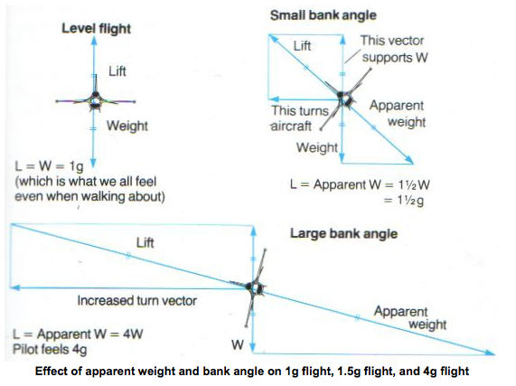

Slide 28
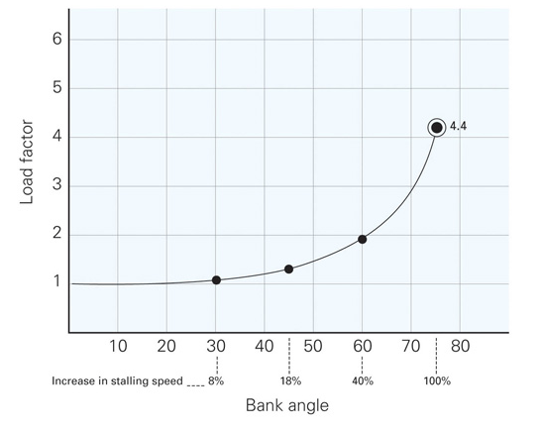
https://www.caa.govt.nz/fig/advanced-manoeuvres/steep-turns/

Slide 29
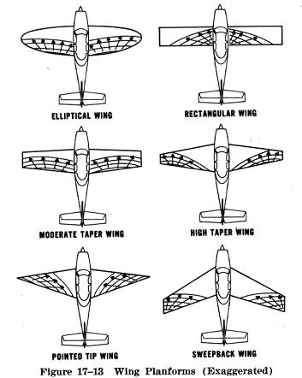
Stall progression for different planforms (perfectly built wings with no twist)

Slide 30
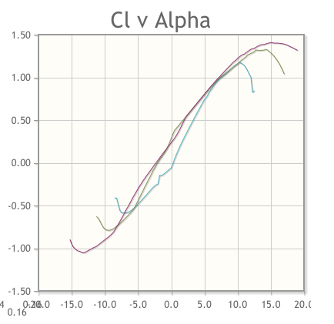
Shorter chord results in lower Reynolds Number R_{n}
Tip may stall first on a tapered wing
C_{l max} (Stall) high R_{n}
C_{l max} (Stall) low R_{n}
C_{l}
NACA 2412 at R_{n}= 50,000, 200,000, and 500,000
α

Slide 31
The Reynolds Number
R_{n} = ρ V x / μ
The ratio of inertial forces to viscous forces
ρ is density of air
V is speed
x is a reference length, usually the chord of a wing section
μ is the viscosity coefficient of air
Correlates with boundary layer behavior
We fly at low R_{n} and there is little wind tunnel data for us
There is computed data for airfoils – airfoiltools.com
For small, slow models and park flyers, a flat plate is almost as good as an airfoil
In some 3D models, thin airfoils with sharp leading edges are used, and yet the stall is still gentle and controllable. Opposite what is expected for a full scale airplane

Slide 32
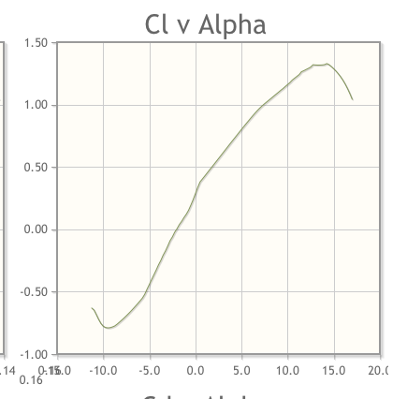
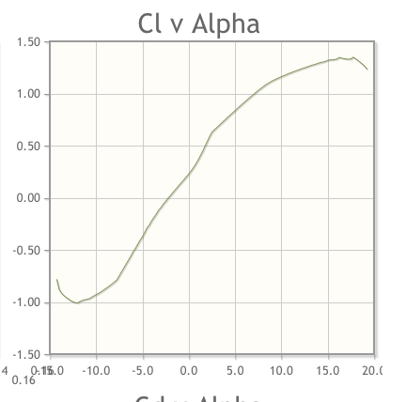
NACA 2412
Airfoils Stall Differently
NACA 2415
Abrupt
Stall
Gradual
Stall

Slide 33
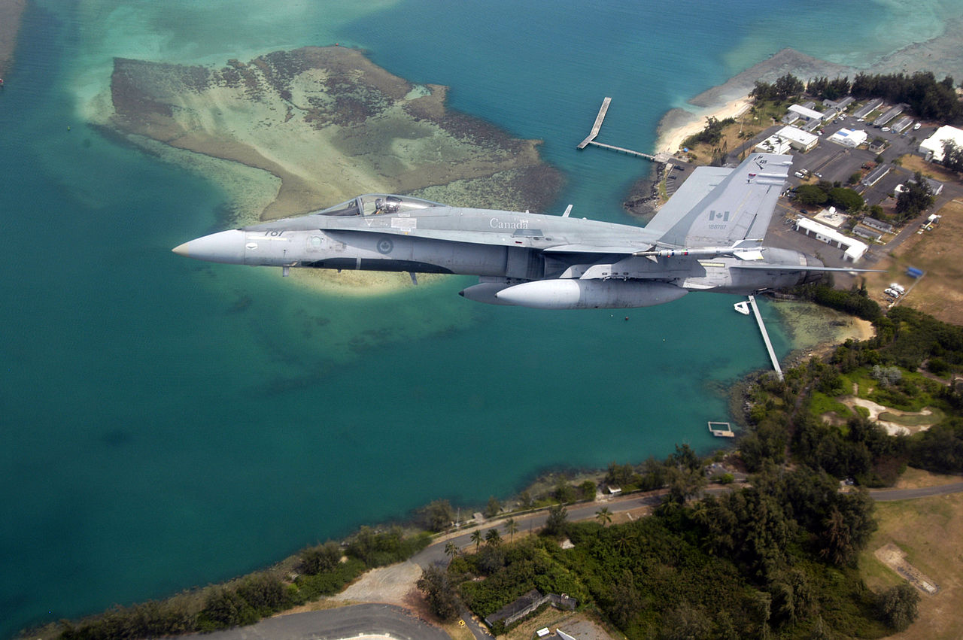
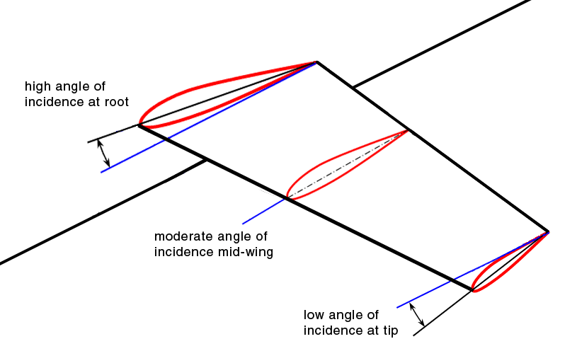
Prevent tip stall
Washout
Stall strips
Different airfoil at tip
Thicker
Rounder LE

Slide 35
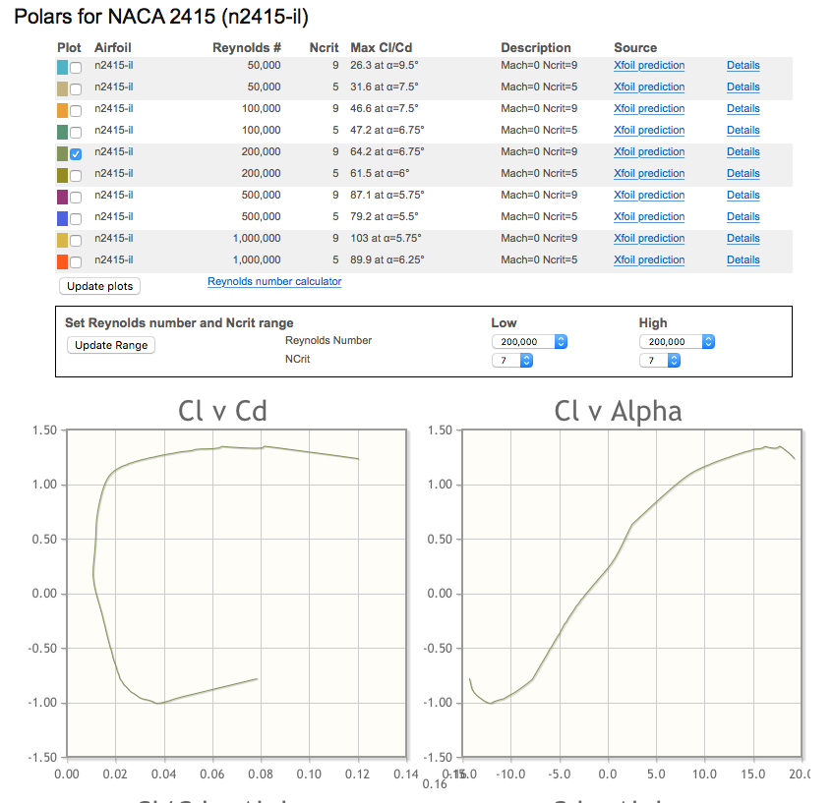

Slide 36
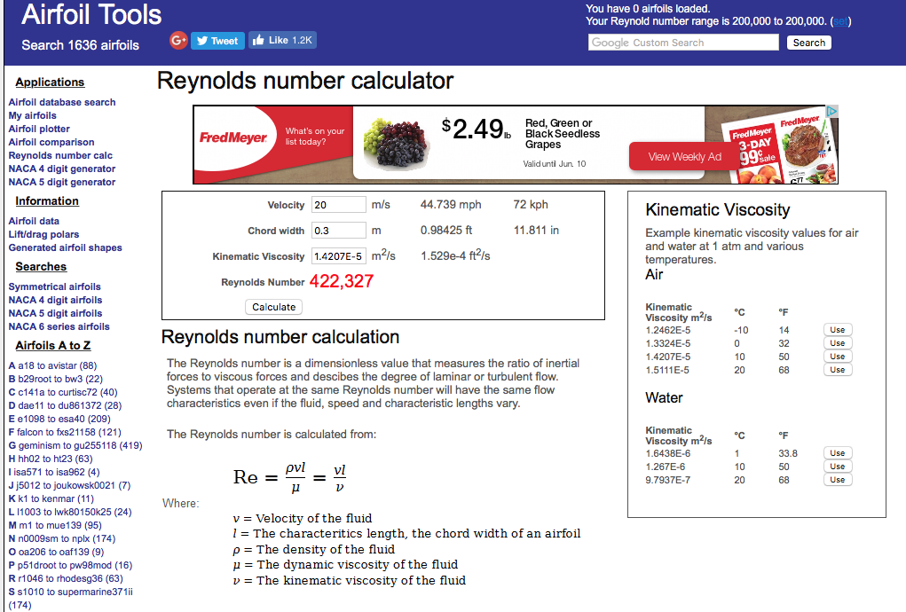

Slide 37
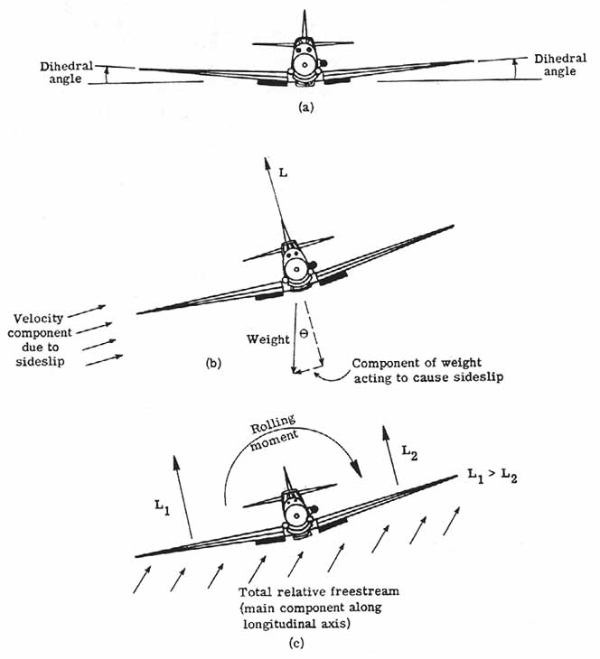
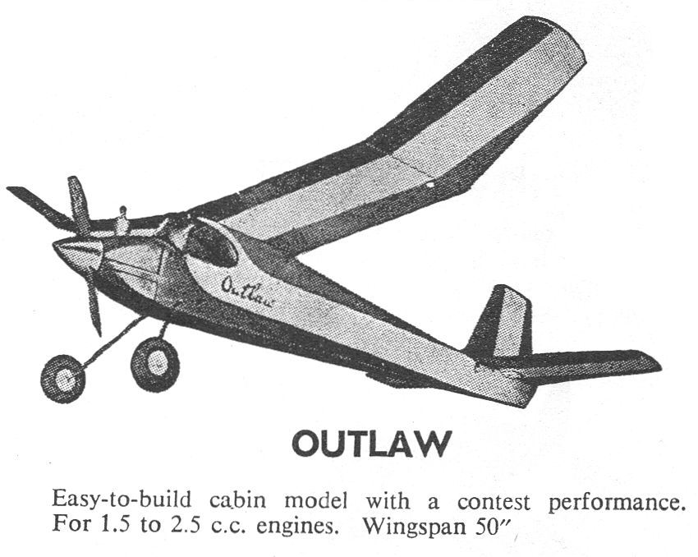
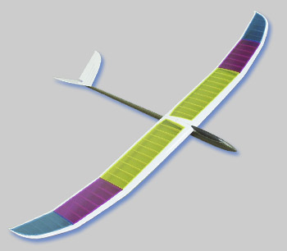
Does Dihedral Help or Hinder?
Tends to restore airplane to wings level

Slide 38
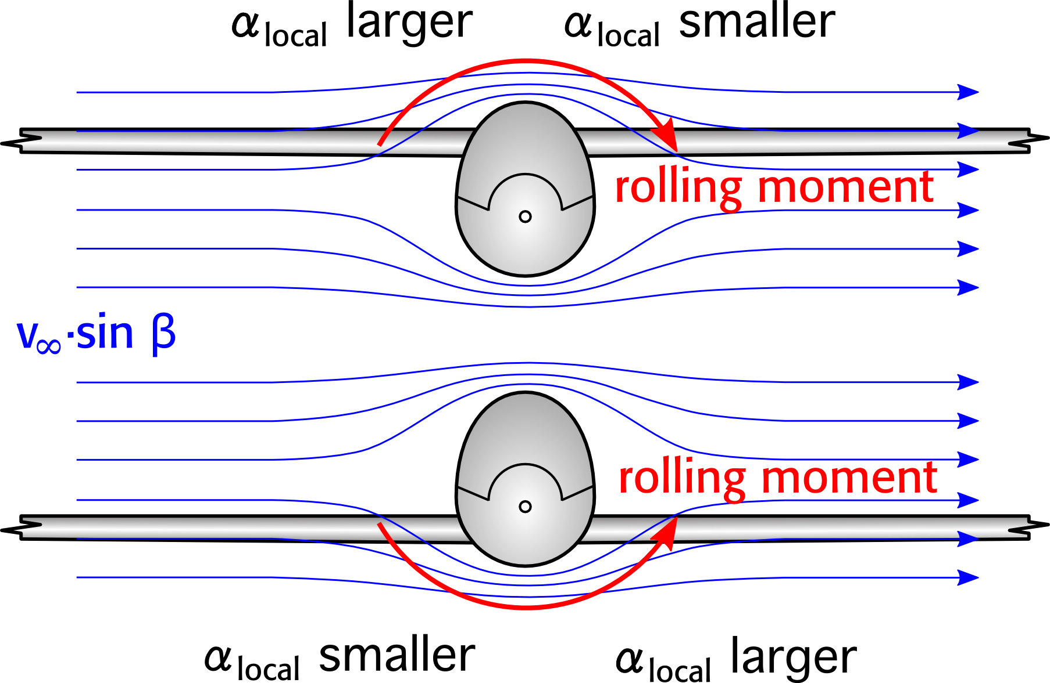
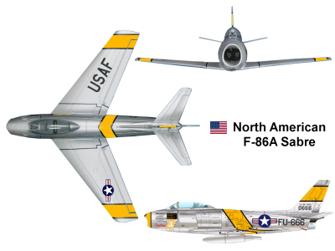
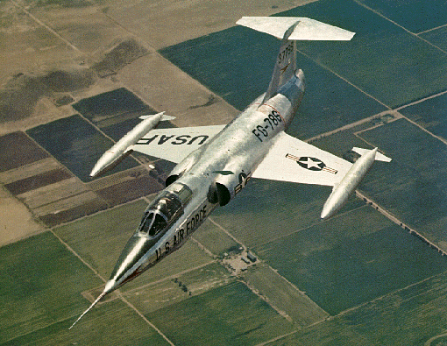
Dihedral Effect - Roll due to Sideslip
High wing
Sweep gives dihedral effect (roll stability) upright or inverted!
Tall T-tail and butterfly tails will also add to dihedral effect
Side slip
angle
β
More lift
Less lift
… so the F-104 has anhedral to compensate

Slide 39
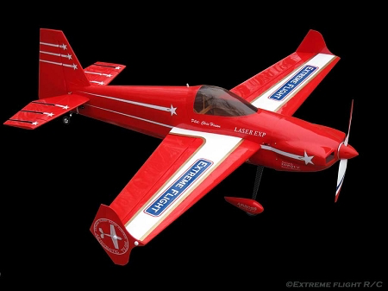
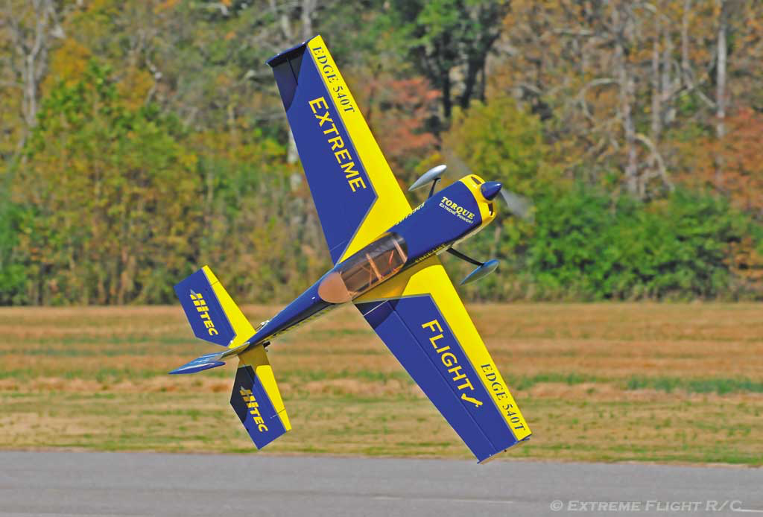
Zero Dihedral Effect
Mid-wing, no sweep
No rolling tendency in knife-edge flight
(very high sideslip angle)

Slide 40
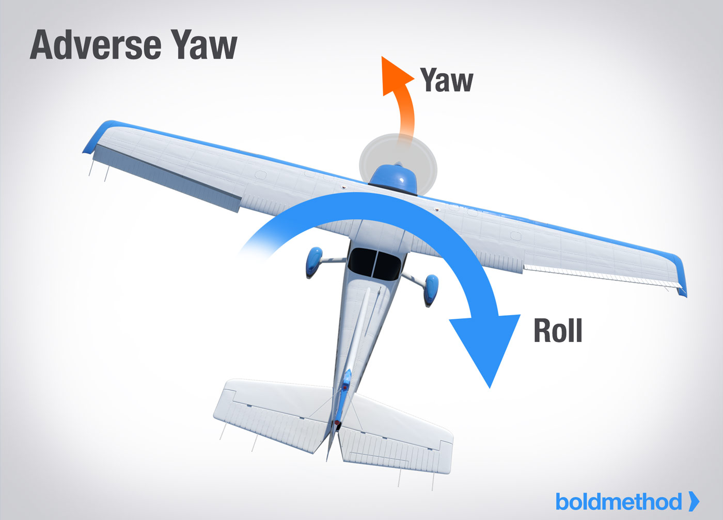
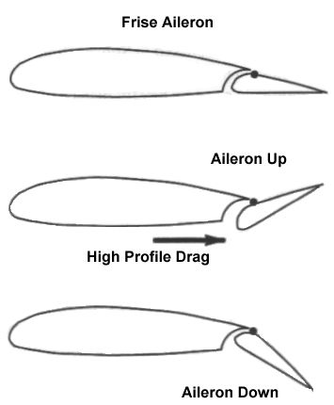
My Plane Won’t Respond To Aileron
“Adverse Yaw”
long wings
vertical fin too small
most noticeable when slow
Fixes:
Use your rudder thumb!
Aileron > Rudder mix (about 50% for a trainer)
Differential Ailerons (more up travel than down)
Frise Ailerons
More
drag

Slide 41
“My plane is hard to control.” Is it Unstable or Too Sensitive?
Roll and Yaw:
Not likely to be “unstable” (unless it has anhedral) or fin and rudder too small
Pitch:
If CG dive test is OK, then surfaces too sensitive or horizontal stabilizer is too small
If dive test is not OK, move CG forward
First, reduce throws
Second, try expo…. Unless it’s a 3D plane, then use for expo for sure
Last, try adding horizontal tail area

