Slide 1

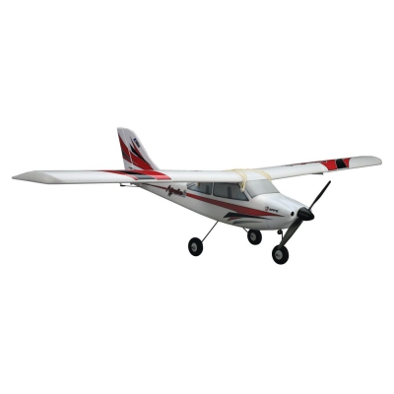
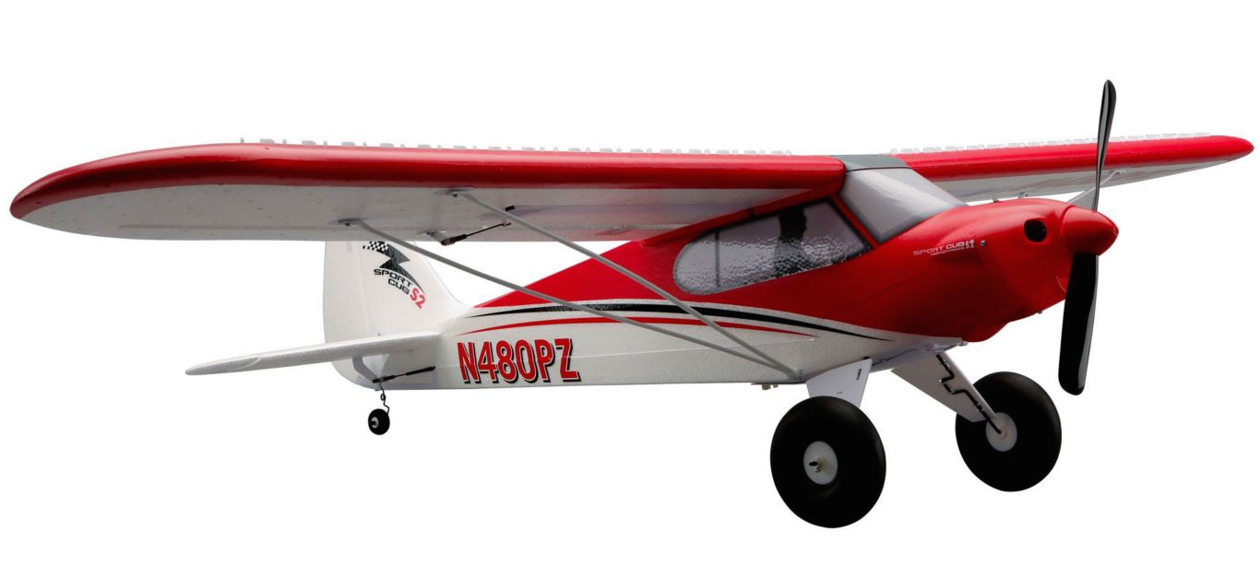
Model Aviation & STEM Day
Marymoor Radio Control Club, Redmond, WA
AMA Charter Club 1610
June 1, 2019
The MAR/C Model Aviation & STEM program is based on a program developed
by the Flying Electrons model airplane club of Menomee Falls, Wisconsin.

Slide 2
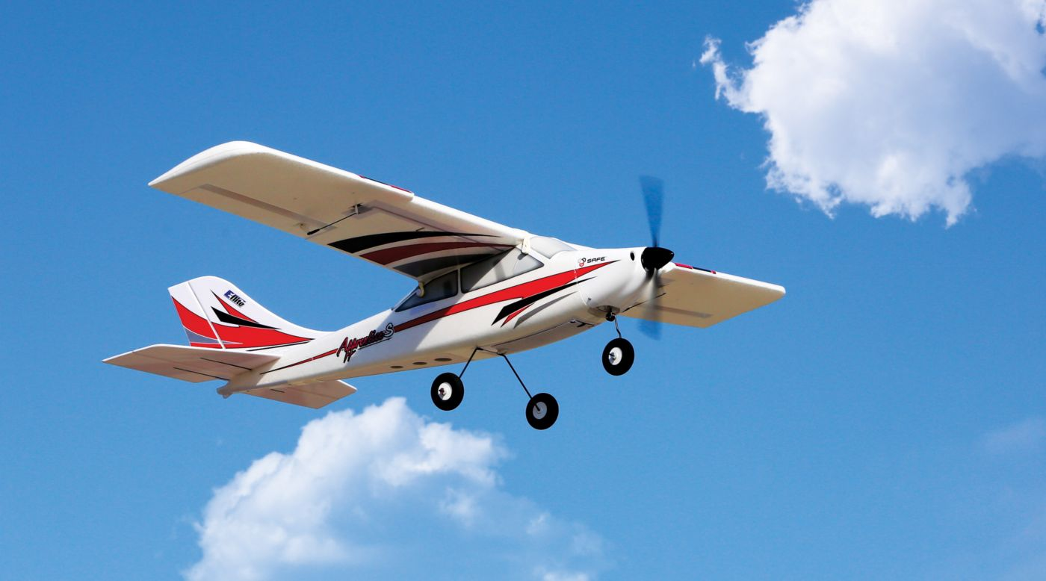
Welcome

Slide 3
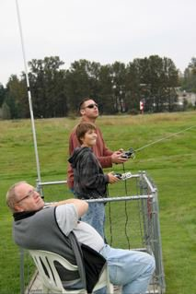

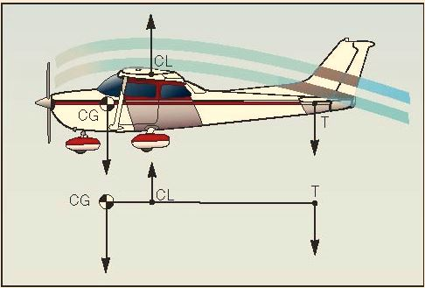
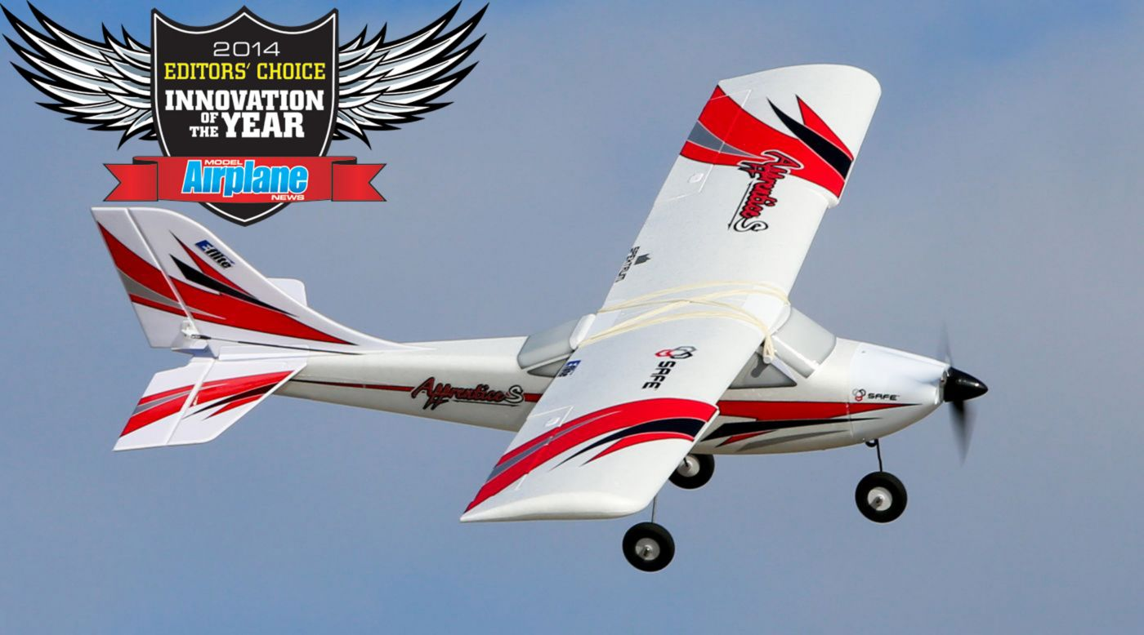
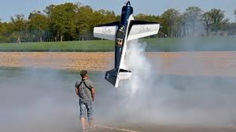
Marymoor RC STEM Day

Slide 4
Today’s Volunteer Team
MC Mike Powell
Ground School Brian Kelly
RC Simulators Mike McGee
Flight Instructors
  Doug Hurley, Brian Connelly, Dennis Sivak, Carl Everitt, Greg Jackson,
  Larry Talbot, John Hurley, Daniel Cherkasov
High Performance Demonstrations
  “3D Ken”
  Zach Sweetster
  Brian Kelly
Cooks!
  Brian Kelly 2, Gene Sartore

Slide 5
Today’s Schedule
 | 9:00 – 9:20 | 9:20 – 10:00 | 10:00 – 10:40 | 10:40 – 11:20 | 11:20 – 12:20 | 12:20 – 1:00 | 1:00 – 1:40 | 1:40 – 2:20 | 2:20 – 2:30
Red Team | Registra-tion Welcome | Ground School 1 | Flight Sim | Fly with Instruc-tor | Lunch High Perfor-mance Flight Demos | Ground School 2 | Flight Sim | Fly with Instruc-tor | Drawing
Blue Team |  | Flight Sim | Fly with Instruc-tor | Ground School 1 |  | Flight Sim | Fly with Instruc-tor | Ground School 2

Slide 6
A few Words about Safety
Stay at the tables or behind, unless you are going out to the runway with your instructor
Stay with your instructor
  If we assign a few of you to an instructor, you can go out to the flying stations and observe while the other students fly – but stay with your instructor
Propellers can cause significant injury.
  If you pick up a plane, keep your hands and face well clear of the prop.
Page 6

Slide 7
Program Objectives
Raise awareness that model aviation is a constructive and rewarding activity
Show how model aviation can reinforce STEM principles
Show how Marymoor R/C can contribute to the community
Introduce students to model aviation
  Learning by Fun!
  Maybe develop a passion
  Our club can help lead to a rewarding career

Slide 8
Marymoor Radio/Control Club (MAR/C) mar-c.org
Promotes the hobby and sport of RC model aircraft
Manages the Marymoor model airfield for King County Parks
We’re Big! 200+ adult members, 100+ Junior members
Join us!
  Join Academy of Model Aeronautics (AMA) first.
    (AMA provides insurance)
  Apply for MAR/C membership with AMA number
  Both are FREE if younger than 19 on July 1 of the current year

Slide 9
Marymoor Radio/Control Club(MAR/C)
  Monthly club meetings
  Summer Fly-ins and scale contest
  FREE flight training every Tuesday
    May through August, 5 PM to dusk
    First flights on club trainer
    After first lesson, student must have own airplane
    mar-c.org
    Flight Training tab

Slide 10
Marymoor Park, Redmond, Washington
Flying Field
King County Parks charges $1.00 to park

Slide 11

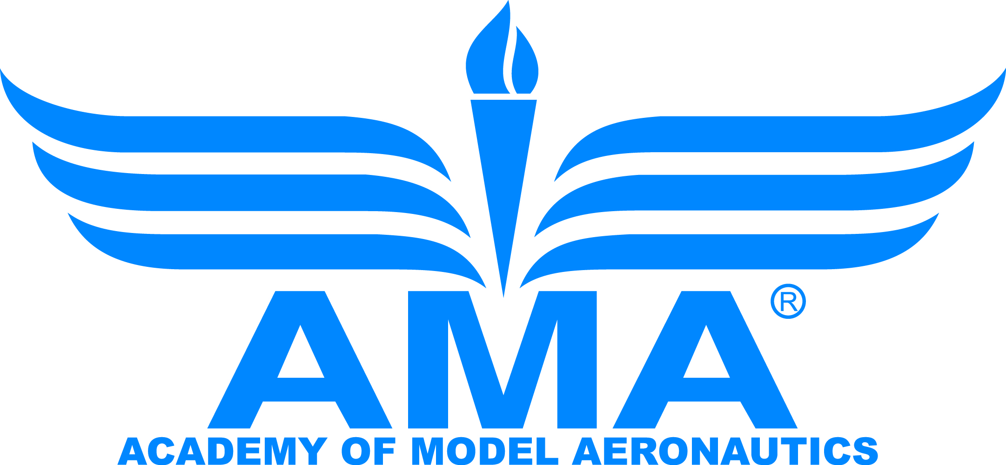
Key Organizations
Academy of Model Aeronautics
USA National Organization
Liability Insurance
Federal agency governing flight
New regulations for drones and
R/C aircraft
Marymoor R/C Club
Chartered by AMA
Manage the field for King County Parks

Slide 12
Academy of Model Aeronautics
World’s largest model aviation association
  200,000+ members
Promotes model aviation as a recognized sport and worthwhile recreation activity
National Aeromodeling Championships
  World’s largest model airplane competition
Chartering organization for 2,500+ model airplane clubs.
  Official contest sanctions, insurance, and assistance in getting and keeping flying sites
Provides liability insurance to members
Liaison with the Federal Aviation Administration (FAA) and other government agencies

Slide 13



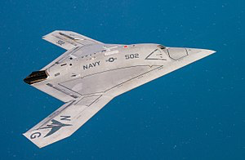

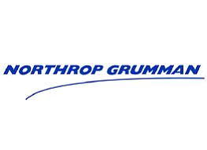

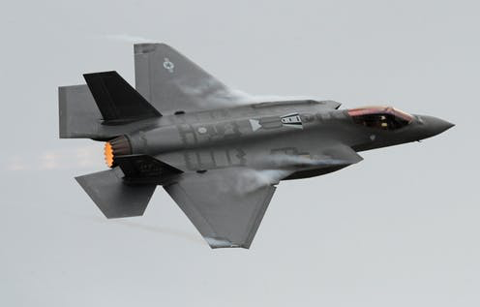


A Job vs A Career
  A job is something that you have to do to earn money
  A career is something that interests you – and you get paid for it!

Slide 14
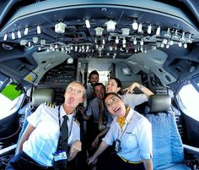

You can even be an airline pilot and have fun doing it!

Slide 15
MANY Aerospace Career Paths
Flight Operations
Pilot
Dispatch
Mechanic
Air Traffic Control
Engineering
Aeronautical, Electrical, Mechanical, Computer Science, Human Factors, etc
Concepts
Design
Manufacturing
Test
Safety
Customer support
Technician
Airframe and Powerplant (A&P) Mechanic
Avionics
Electrical
Mechanical
Structural
Business
Airport management
Program management
Sales
Management
CEO!!
Education: Civil Air Patrol, Aviation High School, Technical Institutes, University, Military Academies, ROTC . . . .
Employers: Aerospace companies large and small, Airports, Airlines, Regulators like FAA, NASA, Military . . . .

Slide 16
Careers of Some MAR/C Members
 | Growing Up | Career
Mike Powell | Built model airplanes, model railroads, took all science and math classes in middle school and high school, BS in Electrical Engineering | Boeing electrical/electronic lead engineer on missile and jet fighter airplanes, now retired and still building and flying model airplanes
Brian Kelly | Model airplanes, private pilot, BS & MS Aeronautical and Aerospace Engineering | Boeing Flight Deck (cockpit) engineer, manager, and Technical Fellow, 757 through 787
Al Watson | Built model airplanes, degree in mechanical engineering | Boeing aerospace engineer and manager. Design of aircraft, missiles, and spacecraft. Supported 13 Space Shuttle launches.
Ian Dougherty | Stick and tissue models at age 9. Marymoor R/C training program in 1999, BS and MS in Electrical Engineering | Software engineer for aircraft computers to prevent collisions of manned and unmanned aircraft
Zach Sweetster | Marymoor R/C training programs as a teenager. Engineering degree | Pilot for Delta Airlines

Slide 17
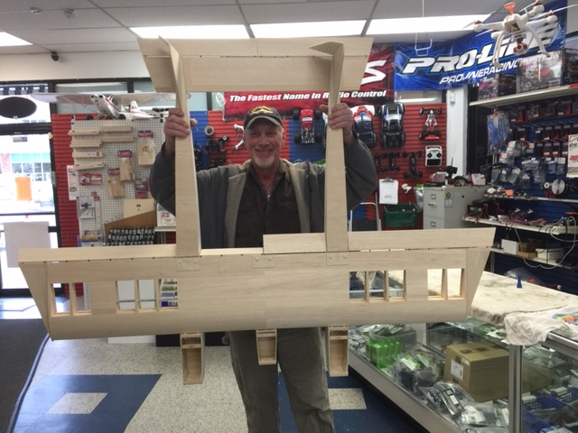
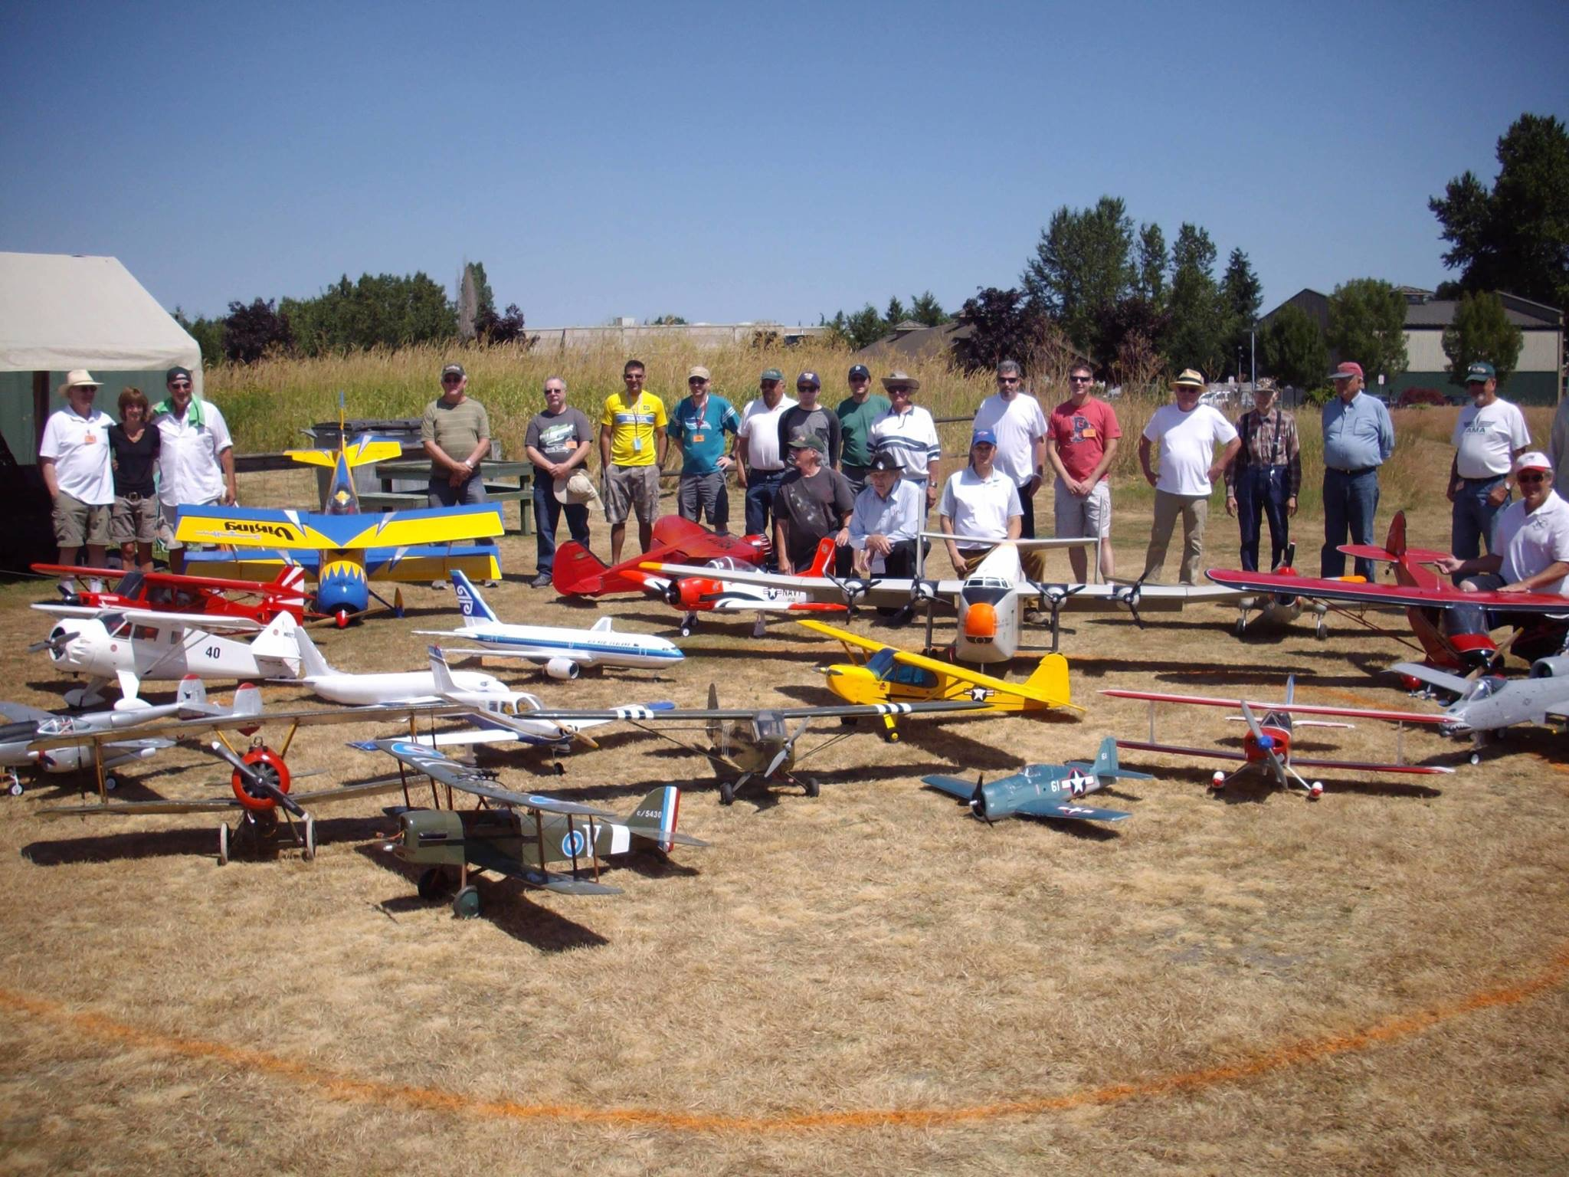
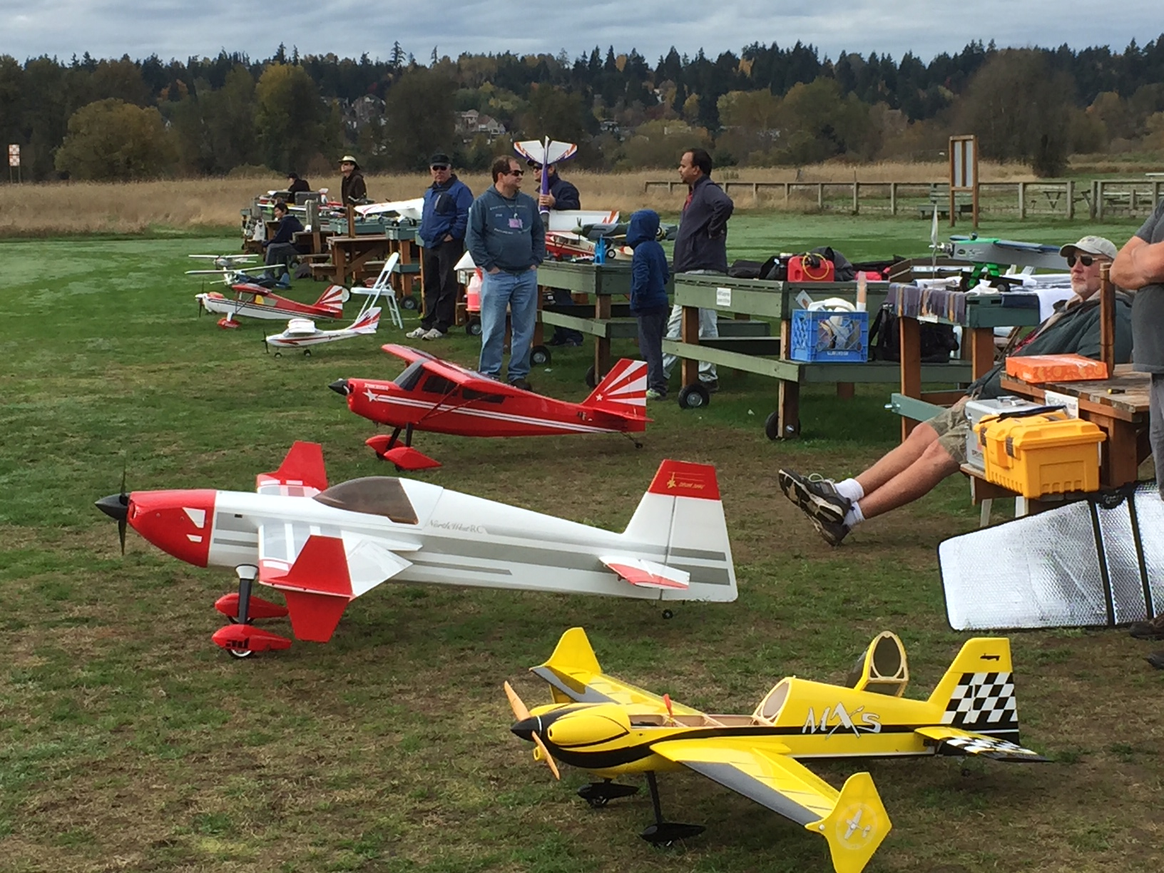
Model Aviation
Economical and fun way to explore flight and engineering
Same science, technology, engineering and math principles as “full scale” aerospace
Design your own!!
“Scale” models – history and engineering
Aerobatics

Slide 18
One Student will win this Apprentice!

Slide 19
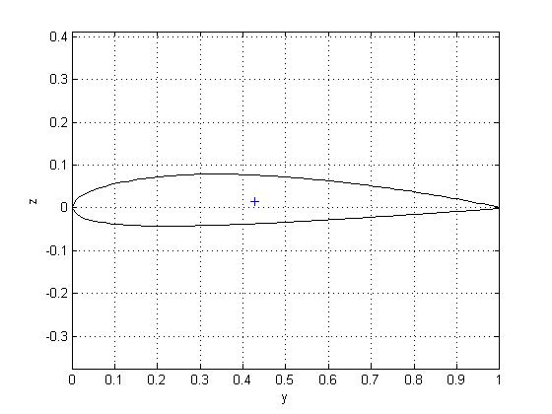
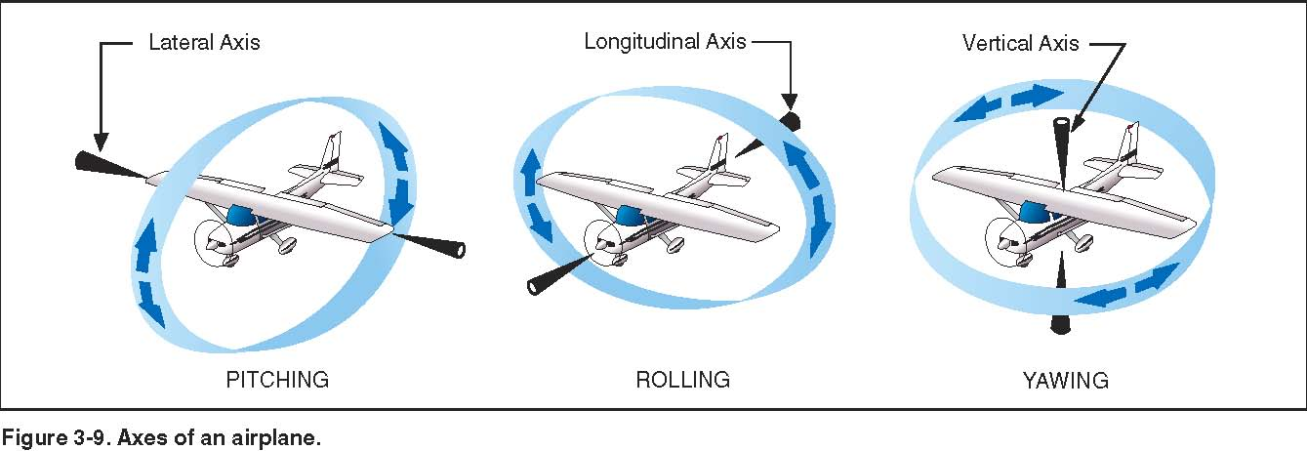
Ground School Part 1
Flight Sciences
Lift
Drag
Direction of flight
Weight

Slide 20
Controls, Aerodynamics & Stability
Aerodynamics, Lift, Weight, Thrust, and Drag
Airplane controls and Axes
Pilot Controls
Stability
Calculating (STEM examples)
        Wing Loading
        Aspect Ratio
        Lift to Drag Ratio
Page 20

Slide 21
Balance of Forces
Lift
Lift comes from:
    Angle of Attack
    Wing Area
    Airfoil Shape
    Airspeed
In level flight, Lift = Weight
Thrust
Drag
Direction of flight
Weight
Page 21
Notes:
PURPOSE
The function of the wing in conventional aircraft is to provide the aerodynamic lift necessary for flight. Control surfaces, ailerons, are mounted on the wing to provide control over the rolling plane of the aircraft.
ESSENTIAL REQUIREMENTS FOR AERODYNAMIC LIFT
Aerodynamic lift is generated by the flow of air over the upper and lower surfaces of the wing as it moves through the air propelled by the motive force of the rotating propeller, jet engine, or, in the case of sailplanes, gravity.
The rate of forward movement through the air, the airspeed, must reach a certain minimum value in order for the wing to generate sufficient lift for to overcome the mass of the aircraft and achieve flight.
The wing must have an appropriate cross sectional shape (in the fore and aft direction), called the Wing Section, or Airfoil Section, in order to generate aerodynamic lift.
The wing must also have adequate wing area, the product of span, (wingtip to wingtip dimension) and chord, (the mean width of the wing in the fore and aft direction). The relationship between span and chord is termed the aspect ratio.
AERODYNAMIC LIFT
An aircraft wing creates lift from the flow of air over both it's upper and lower surfaces. The much larger lift component is produced by the airflow over the upper surface of the wing, the negative-pressure lift. The flow over the undersurface of the wing, the positive-pressure lift, produces a minor component of the total produced and only at positive angles of attack.
The negative-pressure lift, from the upper wing surface, is produced only between a fairly narrow range of Angle of Attack. The angle of attack is the angle between the chord line of the wing and the undisturbed airstream vector impinging upon the wing. A typical range, for a wing of fully symmetrical (uncambered) airfoil section is approximately 0 to +15 degrees. A wing of cambered airfoil section will generally produce a higher lift coefficient than it's uncambered cousin, but will have a slightly different range of lift producing angle of attack, approximately -5 to +12 degrees.
The positive-pressure lift continues to be produced at very large angles of attack, but as drag at such attitudes is so large, this lift is of little practical value.
As an aircraft wing generates lift, it also generates drag; a force acting to retard forward movement. As the angle of attack increases, so do both lift and drag, but at a different rate, lift increasing initially at a greater rate than drag, but drag increasing dramatically at the upper range of angle of attack.
WING DESIGN
The interplay of lift and drag has resulted in aircraft designers adopting many different combinations of wing section, planform, area and aspect ratio. The planform shape of the wing, rectangular, tapered or eliptical is another variable utilized by designers.
Aspect Ratio is the ratio of wingspan to chord. For most RC model aircraft the aspect ratio found to be a good balance between ease of construction and aerodynamic efficiency is between 5 and 6; for example, an aspect ratio of 5 means that an aircraft of 60" wingspan would have a chord of 12".
For simplicity of construction most RC model aircraft designers opt for a rectangular rather than tapered or elliptical planform for powered aircraft. This choice is not the aerodynamic optimum, either for lift distribution or induced drag considerations, however most RC Model aircraft are very adequately powered, so that, in most cases, the drag associated with the aerodynamic lift of the wing is less important than it is in the case of full-sized aircraft. For sailplanes the optimization of the lift/drag couplet is very important and therefore wing planforms, aspect ratio and airfoil sections are usually radically different from those on powered aircraft.
An important consideration for any aircraft designer is the Reynold's number envelope in which the aircraft will operate. The Reynold's number, abbreviated to RN, is a non-dimensional number derived form a mathematical expression whose variables include air density, airspeed and the chord dimension of the wing. It is used as a yardstick in wing section analysis and selection. The aerodynamic regime in which we operate our model aircraft is commonly referred to as Low RN Aerodynamics.

Slide 22
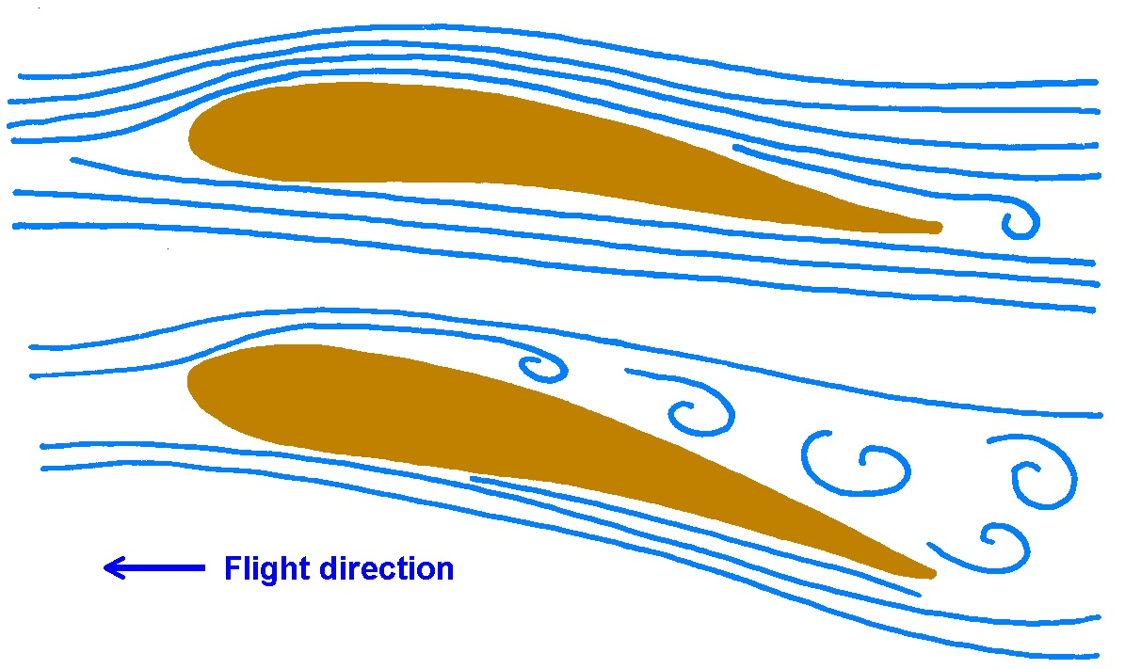
Lift is greatly reduced when the Wing Stalls
Stall can occur when:
          Too slow
          Pulling too much up elevator
          Steep bank angle
          Any combination of these three
Occurs at critical angle of attack, about 15 degrees
Trainers have gentle stall characteristics. The warbird you want to fly someday might not.
One wing can stall before the other, resulting in a sharp roll, and if it continues, a spin. A good trainer won’t do this.
Page 22
Notes:
THE STALL
AN ACCIDENT
The RC model aircraft, a warbird scale model of fairly high wing loading, is on the downwind leg of a left hand landing pattern, flying with a modest tailwind so that it's groundspeed is a little higher than the pilot prefers, so he throttles back and the model's nose drops. He adds a little up elevator to maintain altitude. He turns left onto base leg, banking quite steeply because the tailwind is pushing the model downwind, elongating his pattern. He adds up elevator in the turn to maintain altitude, simultaneously reducing power. He trims the nose up on his base leg, slowing the aircraft. He turns left again, onto final, once again banking quite steeply, about 45 degrees, into the wind and makes his final power reduction. The aircraft is now experiencing a fairly high positive G load and is decelerating. The nose drops in the turn, so the pilot reacts with corrective right aileron and up elevator. The left wing, with the aileron deflected downward, exceeds the critical angle of attack and the lower, left wing, tip-stalls, the aircraft inverts, the nose drops vertically and before a spin can develop the aircraft impacts the earth disastrously. This scene has been repeated many times, tragically, and usually fatally, in full-size aviation, and embarrassingly in model aviation.
WHAT HAPPENED?
When a wing assumes an Angle of Attack, either positive or negative, in excess of the lift-producing range previously described, the airflow no longer conforms predictably to the upper curvature of the wing's surface, but separates and becomes very turbulent. Virtually all lift is lost, and drag increases dramatically. Very often aileron control is jeopardized and the aircraft departs from controlled flight. It has stalled, and is no longer flying, but simply dropping.
It is not low airspeed, but exceeding the wing's critical angel of attack, that induces total flow separation over the upper surface of the wing; the stall. When the pilot of an aircraft attempts to avoid loss of altitude at low airspeed by raising the nose of the aircraft, and therefore increasing the angle of attack, he is in danger of stalling the wing.
WHY?
In any aircraft, model or full-size, the behavior of the wing at critical high angles of attack is most important. As the aircraft's angle of attack approaches the critical value, and stalling is imminent, it is important for continued controlled flight that the wing should not experience tip-stall. If asymmetrical tip stall does occur, the aircraft will abruptly drop the stalled wing, yaw violently towards the stalled wing, and very possibly enter a spin. Many aircraft use wing Washout, a wing twist, to allow the outboard portion of the wing to continue to experience non-critical angle of attack while the inboard section becomes critical, and stalls. By this means aileron control is preserved, to a certain degree, and spinning is avoidable.
Some aircraft also vary the Airfoil Section from root to tip, using cambered section at the root, for higher lift, and non-cambered section at the tip, for higher critical angle of attack.
The Planform Shape of a wing also influences the behavior at the stall. Strongly tapered planforms, where the wingtip chord is significantly less than the root chord, and therefore the Reynold's Number of the tip is much lower that the root, are more subject to tip stall than less tapered, or non-tapered planforms.
At the outboard tip of a wing in flight a strong vortex forms, with overpressure air from the underside of the wing curling up around the wingtip into the underpressure topside of the wing. This vortex creates significant drag and by it's disturbance of the airstream on the top surface of the wing at the tip, reduces the effective aerodynamic span of the wing. Designers have used a wide variety of devices to minimize the drag and span-reduction effects of the tip vortex; winglets, end plates, Hoener shapes and several others. Perhaps the most elegant solution is the adoption of an eliptical planform, such as was used in the Supermarine Spitfire so that the vortex becomes very small and the span-wise lift distribution of the wing is optimized with respect to imposed structural bending moment loads. The Spitfire's wing has a beautiful shape but it is, unfortunately, complex to design and build.
Among the very wide range of RC model aircraft flown today, those of foam construction, with powerful electric motors, have very benign stall characteristics. They generally have very light wing loading and high power loading, so that they perform some remarkable maneuvers with the wing in a fully stalled condition, flying on overpressure lift from the underside of the wing and propeller thrust.
Similarly, the typical trainer has quite low wing loading, and fairly gentle stall behavior. They are designed very carefully to avoid tip-stall, and to keep recovery from the stall simple with no departure from controlled flight.

Slide 23
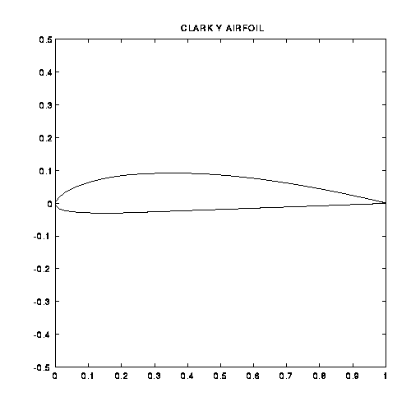

Airfoil Shapes
Flat bottom airfoil
More camber (mid-line is curved)
Trainers and Cubs (Clark Y)
Good at low speeds
“Semi-symmetrical” airfoil
has some camber
sometimes used on trainers
Good all-around airfoil
Symmetrical airfoil
Zero camber - mid line is straight
Used on aerobatic airplanes
Center of lift is very close to 25% chord for almost any airfoil (subsonic)
-- usually near max thickness, best place to put the spar.
Notes:
WING SECTION.
Wing section, or airfoil, is the term used to describe the geometric shape of a cross section of the wing in the fore and aft plane. Wing Sections are assigned names by their developers, for instance, the wing section called NACA 2412 is just one of the many developed by the National Advisory Committee for Aeronautics, a US Federal Government agency now part of NASA.
Wing Sections are all geometric variations of a streamlined teardrop shape. Sometimes they are fully symmetrical, meaning that they do not have camber. Camber is the term used to describe any curvature of a midpoint line joining the extreme points of the wing section at the leading and trailing edges.
Model aircraft designers frequently choose Wing Sections from a vast array available from many sources, such as NASA, rather than develop their own Wing Sections. The Airfoil Section mentioned above, NACA 2412, is a very widely used section. It is one of NASA's four digit series, where the first digit, 2, indicated that the section has camber of 2% of total depth. Second digit, 4, indicates maximum camber located at 40% of the chord. The last two digits indicate airfoil maximum thickness, 12%.
Wing sections are selected by the model designer to suit the intended use and flight characteristics of the model. The aerodynamic characteristics of most wing sections are described mathematically in a series of graphs commonly known as Lift/Drag graphs, or L/D curves. These graphs are the result of wind tunnel tests. As the name implies, these graphs plot the lift coefficient produced by the subject wing section against the induced drag and pitching moment coefficients as the angle of attack is varied.
At any specified airspeed and angle of attack the lift of the subject wing may be calculated using the Lift Coefficient from the L/D graph in a series of mathematical expressions. Similarly the Induced Drag, which is the resisting force resulting from the Lift generated by the wing having the subject Section at a particular airspeed and angle of attack, may be calculated.
Model designers typically choose fully symmetrical wing sections for aircraft intended for aerobatics. Such wing sections are equally effective inverted as they are upright. Model aircraft intended for less inverted flight generally use airfoils having some camber as such airfoils generate higher lift coefficients than do symmetrical airfoils at positive angles of attack.
Section thickness is another variable. Thin sections have lower induced drag than thicker sections, all other factors being equal. Practically, for RC model use,
a reasonably thick wing section between 10 and 14 percent of chord provides for adequate depth of spar, (to resist imposed loads in flight), and ease of construction. Thinner wings are used for high speed applications where low drag is important, such as pylon racers or turbine powered aircraft.

Slide 24
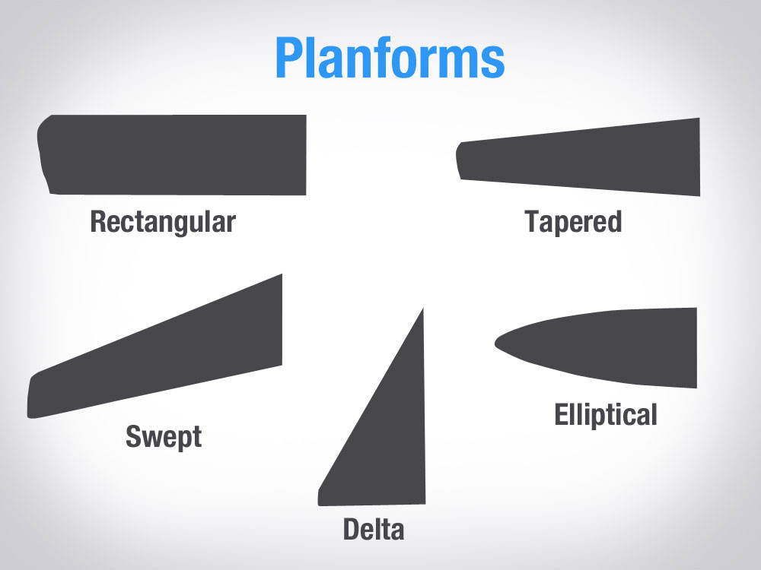
Where’s the Center of Lift?
?

Slide 25
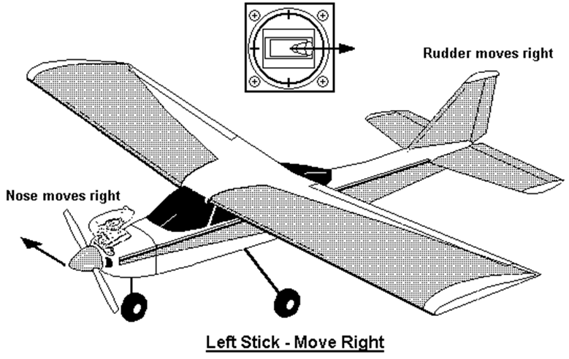
Basic Airplane Components
Vertical
Stabilizer
Rudder
Right Aileron
Elevator
Wing
Horizontal
Stabilizer
Left Aileron
Fuselage
Page 25

Slide 26
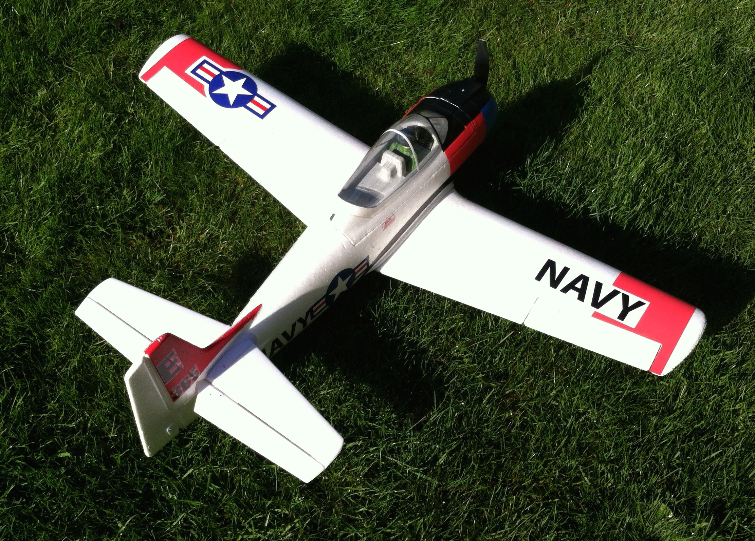
Ailerons, Elevators, and Rudder
Control Roll, Pitch, and Yaw
Ailerons
    Roll, left and right
Elevators
  Pitch, up and down)
Rudder
  Yaw, left and right
Page 26
Notes:
LATERAL CONTROL, AILERONS.
Ailerons are moveable control surfaces mounted on the trailing edge of both wings. They control the rolling plane of the aircraft. They are deflected differentially.
As the ailerons are deflected differentially by pilot control input from their neutral position, (one up, the other down), they alter the airfoil camber, either in positive or negative sense, and therefore increase or decrease the lift coefficient of the airfoil and, of course, the drag coefficient, and thereby roll the aircraft.
In the case of the downward deflecting aileron the increased positive camber produces increased lift, and also the associated increased drag, whereas the other aileron, defecting upward has the opposite effect, producing reduced lift and reduced drag. The unfortunate result is that the differential drag produces an unwanted yaw in a direction opposite to the commanded roll. This is termed Adverse Roll.
Adverse roll is most widely countered by setting up the ailerons such that the downward deflecting aileron has less travel than the upward moving aileron, so that the downward deflecting aileron is operating in that range of the L/D curve where the rate of increase in lift coefficient is far greater than the rate of increase in the drag coefficient. Conversely the upward moving aileron, with it's greater deflection reduces the lift coefficient and to a greater extent, the drag. This setup is termed "Differential Ailerons". For example, an aircraft might be set up with the upward deflection of the ailerons at 30 degrees maximum, and the downward deflection at 15 degrees maximum.
An alternative is the use of "Frise Ailerons", a design wherein the aileron hinge line is a short distance aft of the aileron leading edge, and leading edge of the upward deflecting aileron is deflected down and exposed beyond the surface of the underside of the wing, thereby creating drag. This drag acts to oppose the drag associated with the increased lift created by the downward deflecting aileron on the other wing. Adverse yaw is reduced or eliminated. A further refinement of the Frise aileron design allows the protruding leading edge of the negative lift aileron to scoop positive pressure airstream from the lower surface of the wing and eject it upward through a contoured slot between the leading edge of the aileron and the wing into the airstream passing over the upper deflected body of the aileron. This jet of high-energy air enhances the effectiveness of he upward deflecting aileron.

Slide 27
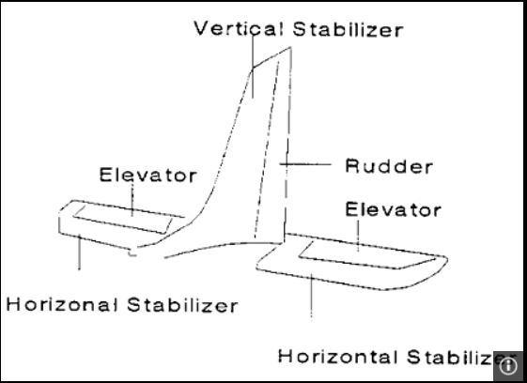
Empennage (The tail Group)
Large tail surfaces, longer aft fuselage, and relatively small elevator and rudder result in , more stable airplane with smoother control.
Page 27
Notes:
The Empennage is the term often used to describe the tail group of an aircraft; the horizontal fixed stabilizer, the movable elevator control surface, the fixed vertical stabilizer and the movable rudder control surface.
In conventional aircraft the empennage is positioned aft of the wing and mounted at the aft end of the fuselage. The distance between the center of lift of the wing and the center of lift of the horizontal tail group is called the tail moment arm.
The horizontal group, (stabilizer and elevator), act in flight to counteract the pitching moment of the wing airfoil and control the aircraft in the pitching plane. The stabilizer is fixed at a slight negative angle of incidence with respect to the wing such that in level constant airspeed flight the downward aerodynamic force acting upon the horizontal tailplane group balances both the downward pitching moment of the wing airfoil and the usual placement of the longitudinal center of gravity slightly ahead of the wing's center of lift.
The horizontal group airfoil is normally uncambered, operating at a slight negative angle of attack in level stable flight. The movable elevator surface, when deflected, creates a momentarily cambered airfoil, and hence either positive or negative lift, and therefore alters the pitch attitude of the aircraft.
The vertical tail group functions in exactly the same manner to control the yawing plane of the aircraft.
The empennage act much like the tail feathers of an arrow, to damp and eliminate pitch and yaw disturbances from level flight caused by air turbulence. In order to achieve this damping effect, the center of lateral area of the aircraft's fuselage and vertical fin must be slightly behind the center of gravity of the aircraft.
The empennage, in particular the vertical component, contribute to spiral stability when the fin area is carefully chosen and located.
The empennage is strongly influenced by downwash from the wing and by the spiraling slipstream of the propeller. The downwash is a variable condition, depending upon airspeed and angle of attach of the wing and the resultant trim changes are usually countered by control input from the pilot.
When the fin is positioned above the thrust line of he engine the spiral slipstream from a normally rotating propeller impinges upon the left, port, side of the fin with an angle of attack that produces lift the right, starboard side, resulting in a yaw to left, or port. The spiral slipstream can be partially reduced by an angular offset of the engine's thrust-line, usually to the right, starboard side, so that the slipstream impinges upon the fin with an zero angle of attack.

Slide 28
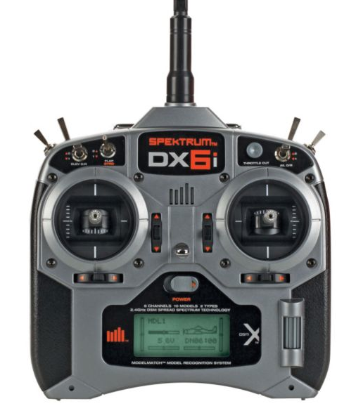
Radio Controls
Elevator
(Pitch)
Power
Rudder
(yaw)
Ailerons
(Roll)
Trim Controls
Page 28

Slide 29
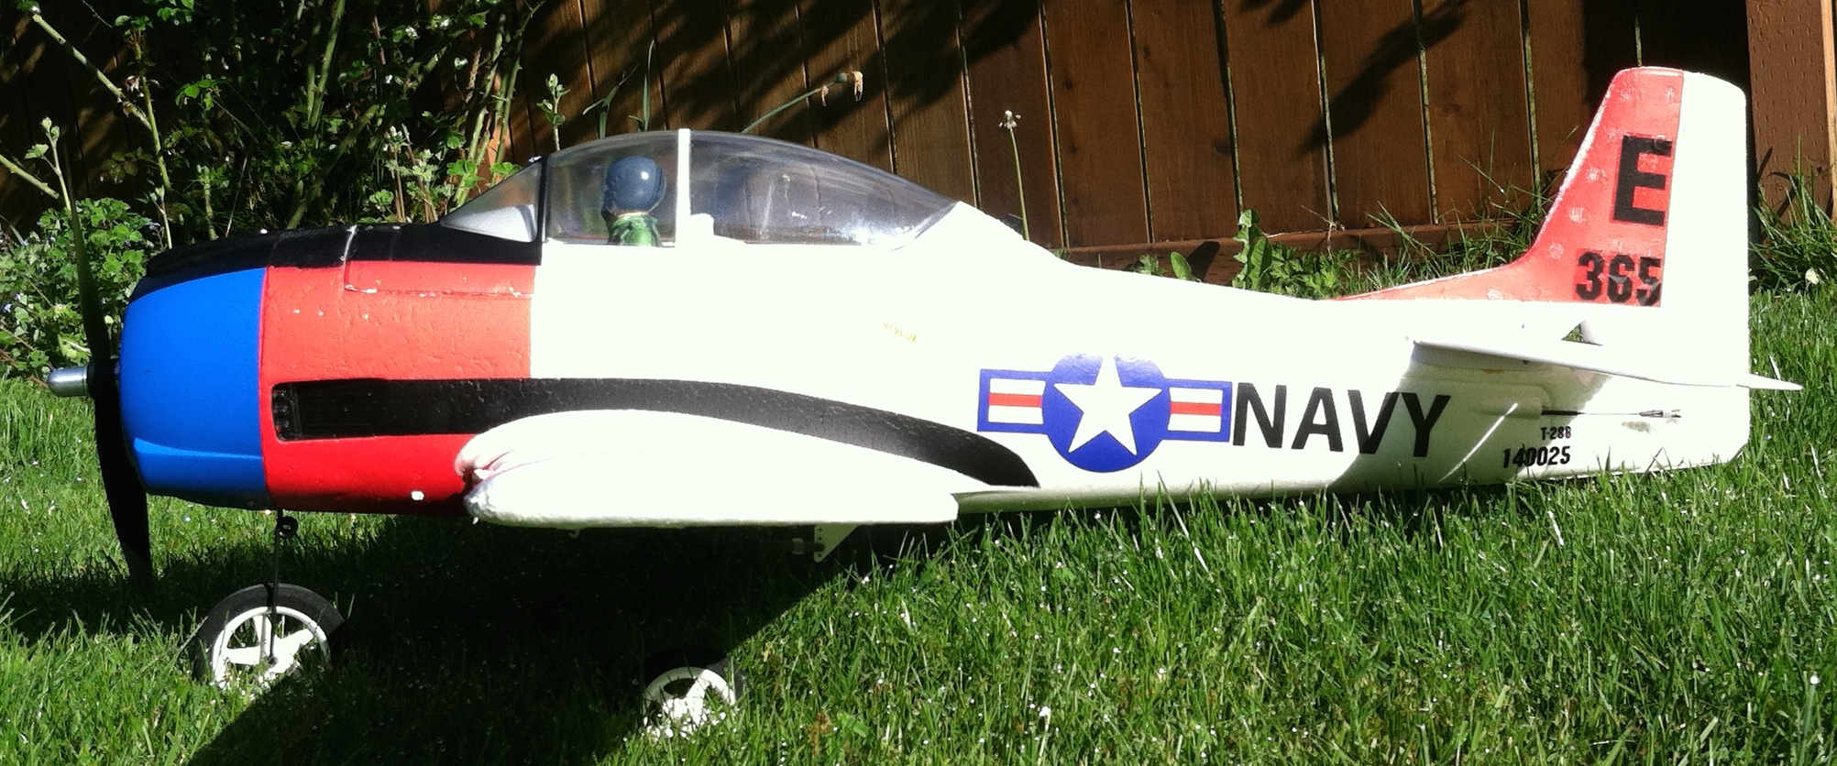
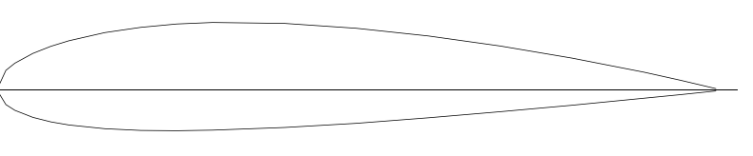
Stability in the Pitch axis
LIFT
Small
Down
Force
WEIGHT
Center of
Gravity (CG)
Balance Point
Center of Lift
about 25% of Mean Aerodynamic Chord (MAC)
About 10-20% MAC for stability
CG can be aft of center of lift for aerobatics
  Too far aft, and the “neutral point is reached (truly unstable)

Slide 30
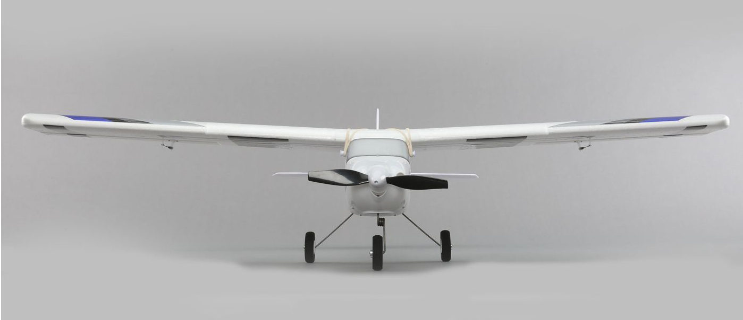
Roll Stability
Dihedral effect helps to level the airplane in roll, making it easier to fly
Dihedral
angle
A zero dihedral, high wing airplane
will still have some dihedral effect
Swept wings have dihedral effect
Aerobatic airplanes usually have zero
dihedral so they also fly well upside
down
Page 30
Notes:
Lateral Balance.
The aircraft must be balanced laterally in order to achieve stable, "hands off" level flight. It is possible to correct for lateral imbalance by use of aileron trim, but only within a narrow airspeed range. A model that is so trimmed will not track properly in maneuvers involving airspeed variation.
STABILITY AND TRIMMING
Trimming for flight is the process of adjusting all the forces acting upon the aircraft in flight in order to achieve stable 'hands off" flight. The forces are lift, both from the wing and from the horizontal tailplane; thrust, both quantity and vector; drag; and gravity, acting through the CG.
Accurate airframe construction is essential for proper trimming. Warped, mis-shapen or twisted models cannot be properly trimmed. When an aircraft is accurately built trimming is largely a process to ensure that control surfaces are truly neutral at rest and that the CG is correctly located, and that engine trust vector is in accordance with the design. An accurately built model will fly straight and level without significant control surface trim adjustment.
Aircraft can be trimmed for strong positive stability, such that they will recover quickly from any disruption of level flight, either in pitch, roll or yaw and return to that condition without pilot control input. Such aircraft are termed strongly auto-stable in flight. Good examples are soaring sailplanes, with their polyhedral wings, and most trainers.

Slide 31
STEM Example – Wing Loading
1
Weight divided by Wing Area
For full scale airplanes engineers use Pounds / sq. Ft
For RC we use ounces / square feet
1
RC Model Type | Wing Loading oz./sq. ft.
Gliders & Park Flyers | 4 to 9
Trainers | 9 to 15
Sport Planes | 10 to 20
Aerobatics | 10 to 15
Scale | Up to 50 for large models
Electric Ducted Fans | Up to 25
Models with low wing loading tend to feel ‘floaty’ and can fly slowly without stalling.
Those with high wing loading must fly faster to avoid stalling

Slide 32
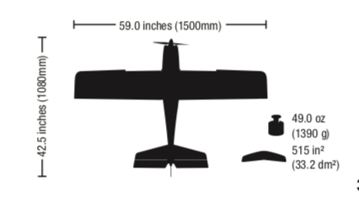
Wing Area, Apprentice Trainer
1
Wing Area = Chord X Span
= 11 in. x 59 in.
= 649 square inches
649 sq in / 144 sq in per sq ft = 4.5 sq ft
1
Wing span
Average chord
11 inches

Slide 33
Wing Loading
Apprentice Trainer
1
1
Wing Loading = Weight in Ounces / Wing Area in Square Feet
Weight = 49 oz
Wing Area = 4.5 sq ft
Wing Loading = 49 oz / 4.5 sq ft = 10.9 oz / sq ft
Would this airplane be a good trainer?

Slide 34
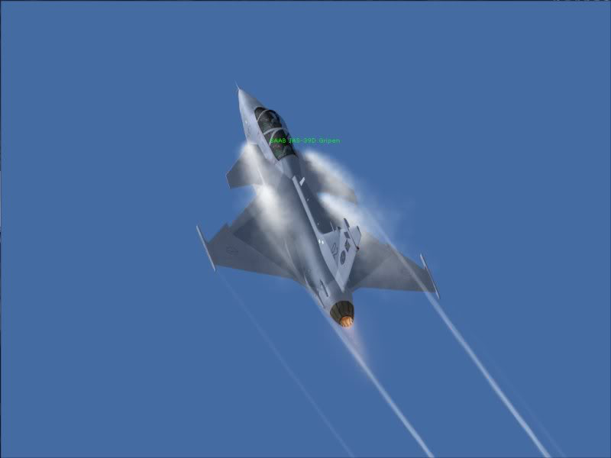
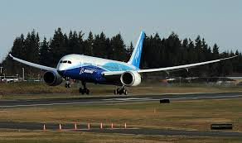
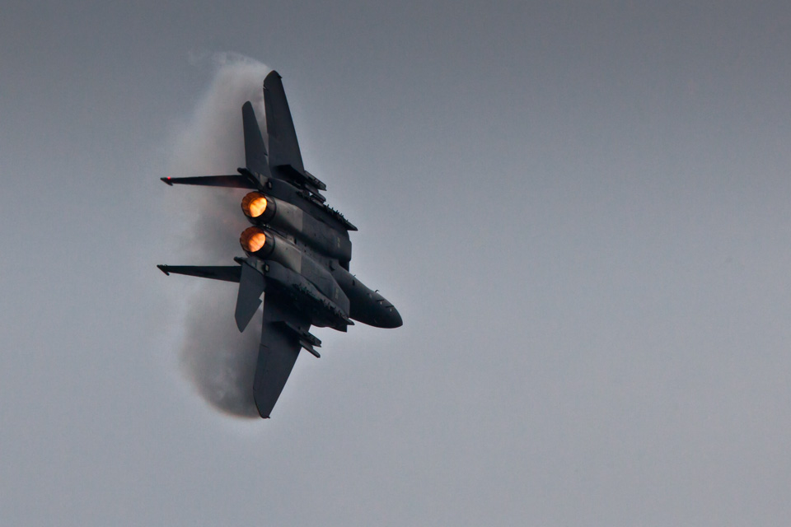
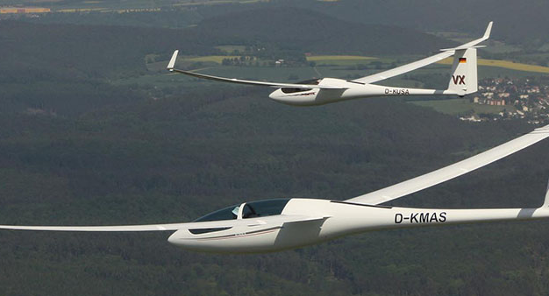
Wing Aspect Ratio
Short wings or long and skinny ones?

Slide 35
Aspect Ratio
1
1
AR = span / chord
AR = 59 / 11
AR = 5.36
Airplanes typically have AR around 5 to 12
Sailplanes have AR 15 or more
High AR gives less Induced Drag or “drag due to lift”
Wing span
Average
chord
11 inches

Slide 36
Why is Aspect Ratio so Important?
1
1
Drag = Parasite Drag + Induced Drag
    Parasite Drag is friction and “form drag”
    Induced Drag is “drag due to lift”
Induced Drag is proportional to Lift² / AR
So a large AR results in low induced drag

Slide 37
Aspect Ratio
b (span)
S (area)
c (chord)
AR = b/c for a rectangular wing
Or..
AR = b²/S for any planform shape

Slide 38
Lift to Drag Ratio, L/D
Fighters have short wing span for maneuverability and supersonic flight.
Low AR, low L/D
High drag, so high thrust needed
1
1
Sailplanes and jetliners have high AR, therefore high L/D
Can glide far with NO thrust!

Slide 39
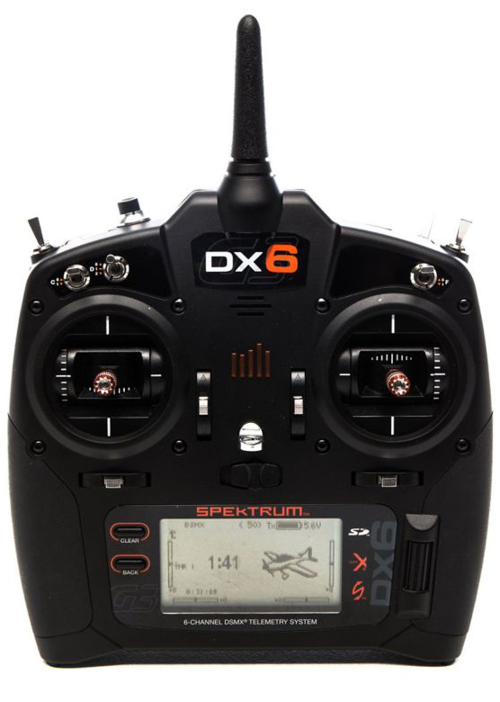
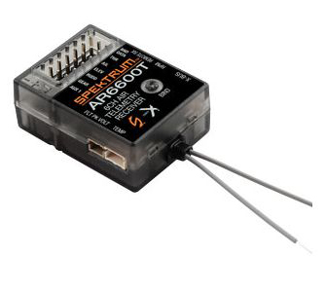
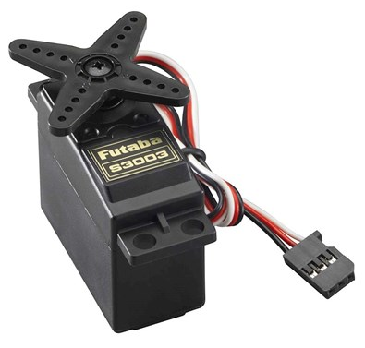
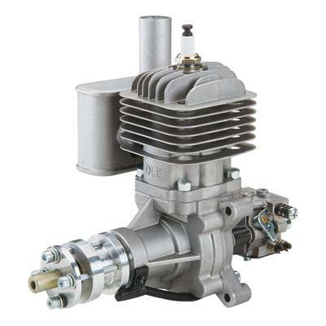
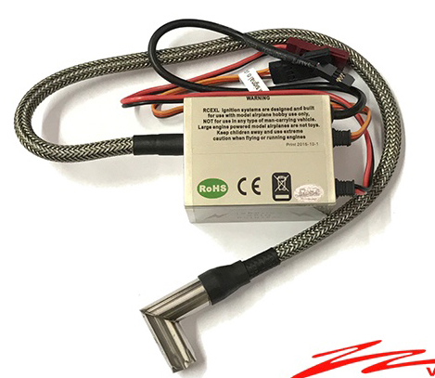
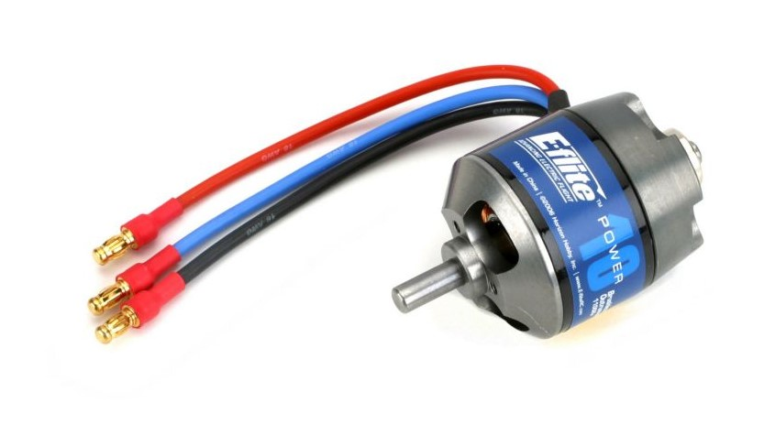
STEM Presentation Part 2:
Radio Control
Propulsion

Slide 40
Radio Control Technology and Propulsion
Pilot controls
How RC components work together
Signal strength
Propulsion
Battery technology
Power Loading of an airplane
Assessing how our Apprentice trainer fill fly
          Wing loading
          Aspect ratio
          Power loading
          Controls
Page 40

Slide 41
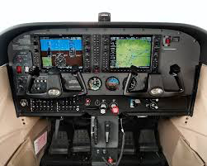
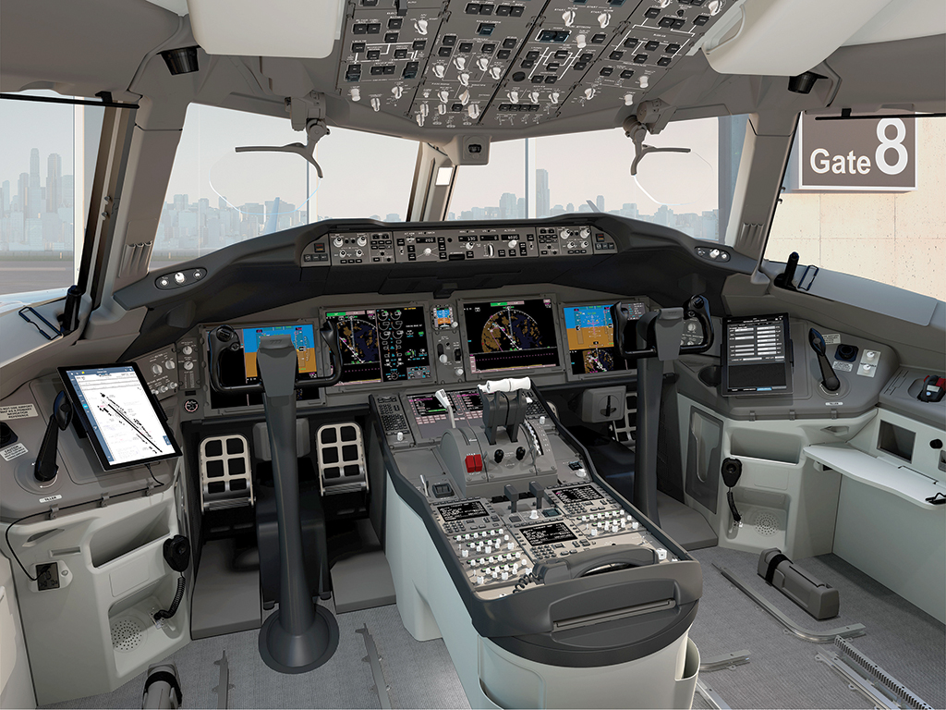
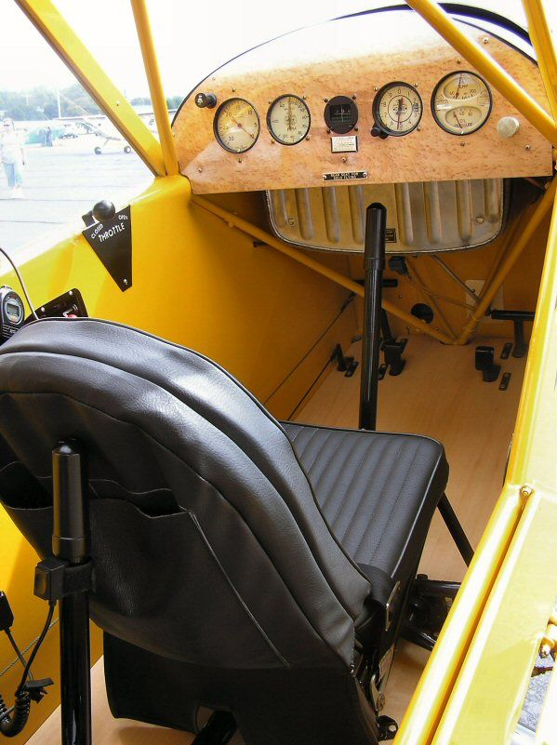
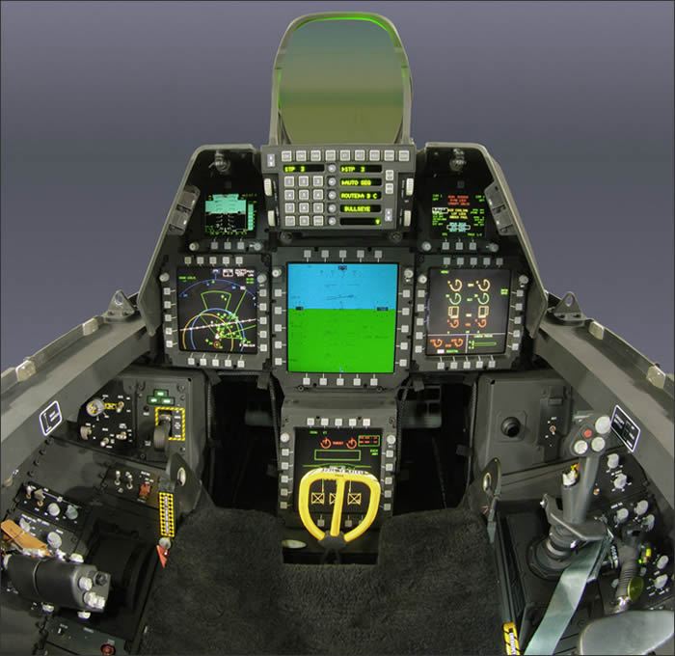
Airplane Pilot Controls

Slide 42
RC Pilot Controls
Rudder
Aileron
Throttle
Elevator
Trim

Slide 43
Spektrum DX6 Transmitter
Antenna 1
Trainer
Antenna 2 Inside Case
Flaps
Landing Gear
Throttle Cut
Rudder
Aileron
Throttle
Elevator
Trim
Programming

Slide 44


Radio Control – Electric Motor
Speed Controller
Flight Battery
Throttle
Elevators
Pilot
Commands
Telemetry
Rudder
Ailerons

Slide 45
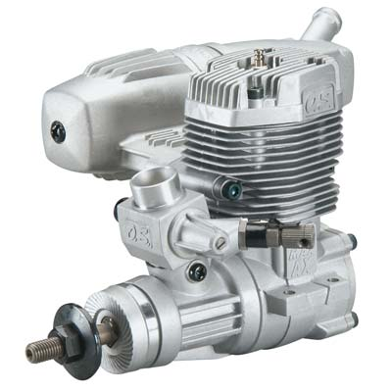
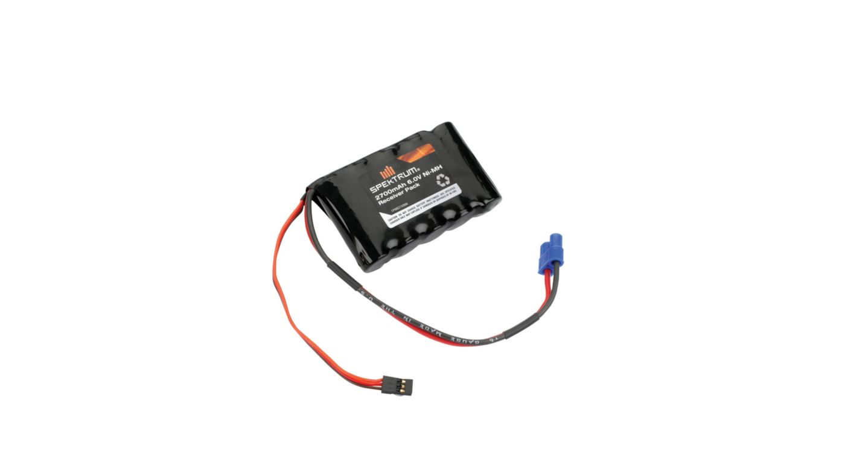
Internal Combustion Engine
Fuel Tank
Throttle
Elevators
Pilot
Commands
Telemetry
Rudder
Ailerons
Onboard battery

Slide 46
2.4 Ghz Transmitter
Sends commands to the flight receiver
  About 450 times per second
Frequency band: 2.4 GHz
Transmission protocol
  Direct sequence, spread spectrum
  Frequency hopping
Displays telemetry data from the airplane

Slide 47
Receiver
Decodes signals from the transmitter and drives servos
Remote
Receiver
RPM Sensor
Bind/Data
Throttle
Aileron
Elevator
Rudder
Gear
Aux1
XBus
Voltage
Sensor
Temp
Sensor
Antennas

Slide 48
Signal Strength
1
Signal strength is a function of distance
Strength ~ 1 / D²
1
500 feet
Signal Strength here
= 100 / 500²
= 100 / 250,000
= .0004
If Signal Strength here = 100

Slide 49
Propulsion
Electric motor
  Most reliable, simplest
  Quiet
  Highly recommended for new fliers
“Glow” engine
  Expensive ethanol fuel
  Need starter, must be “tuned”
  Fuel tank and lines
Gasoline engine
  Need starter, must be “tuned”
  Electronic ignition
  Fuel tank and lines

Slide 50
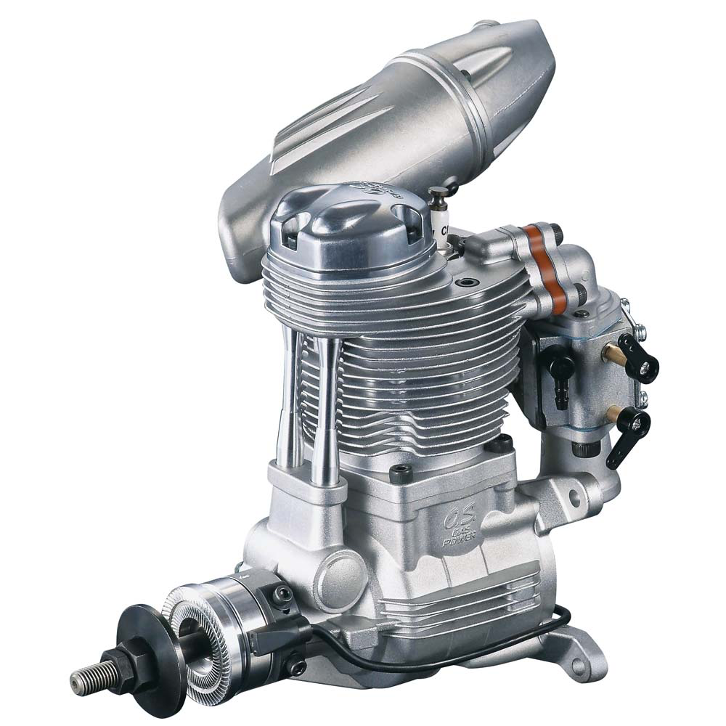
Internal
Combustion
Engines
Design
2-stroke
4-stroke
Fuel & Ignition
Ethanol with a “glow” plug
Gasoline with spark plug and electronic ignition
Oil is mixed with the gas or glow fuel for lubrication

Slide 51
Electric Motor System
Electronic Speed Control
(ESC)
Lithium Polymer (LiPo) Battery
Outrunner Electric Motor
To Receiver
The battery provides Direct Current (DC) voltage to the ESC
The ESC reduces volts to 5.5 DC for the receiver
The ESC provides Alternating Current (AC) to the motor
Power cycles on-off-on-off very fast to control speed of motor

Slide 52

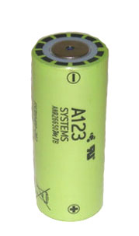
Battery Technology
Used in RC for motor power
OK for high current
High energy density
Can catch fire if damaged or charged improperly
Lithium Polymer (LiPo)
For lower power uses like the receivers and servos
Not capable of high current
High energy density
Safer than LiPo
More expensive
Lithium Iron Phosphate
(“LiFe” or LiFePO4)
For lower power uses like the receivers and servos
Not capable of high current
Medium energy density
Very safe
Economical
Nickel-Metal-Hydride

Slide 53
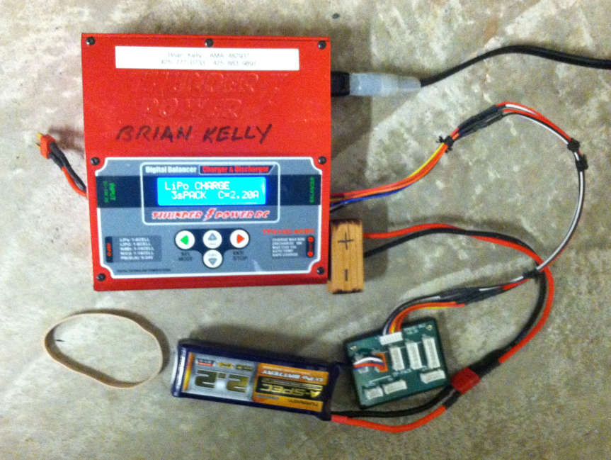
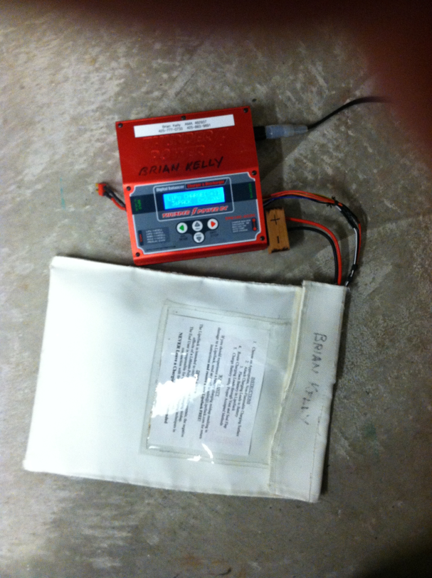
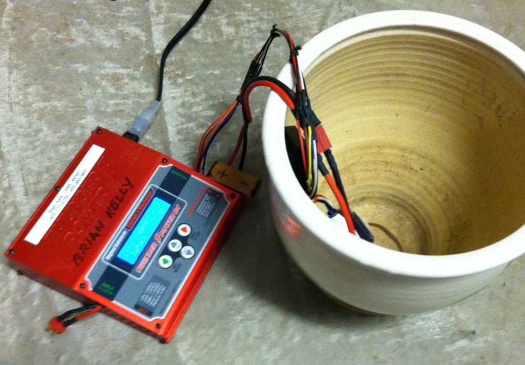
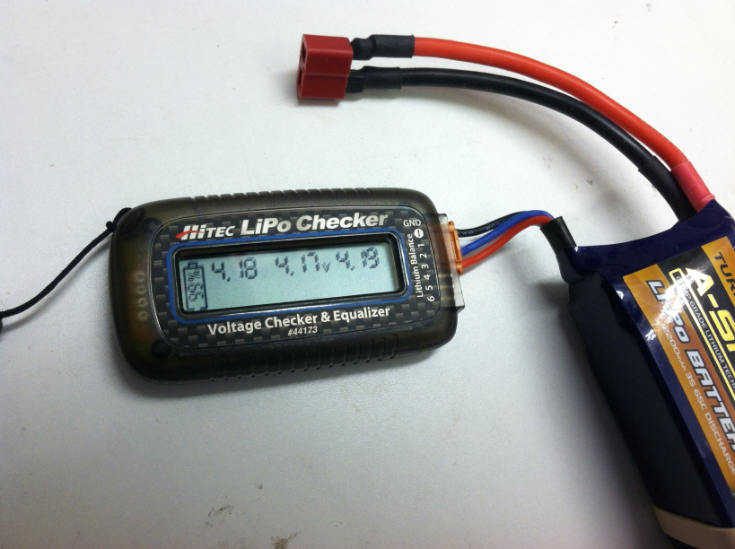
Safety: LiPo Batteries
Charger
connections
LiPo batteries can catch fire if not treated properly.
Always charge batteries in a fire-proof container like a flower pot or a Lipo bag. Never charge inside a car.
Read all the warning material that comes with your charger and battery. Charge at the recommended current or “C” rate.
Always fly one flight only with a fully and freshly charged battery
Never run the battery all the way down. This will damage the battery. Make sure at least 25% is left. Use the battery checker after each flight to learn how many minutes of flight the battery is good for. Use count-down timer to limit the time of every flight.
Do not store your batteries for more than a few days fully charged. This will limit their life.
Understand your charger. When charging a battery ensure that you have the polarity on the battery correct before charging. Red goes to red and black goes to black.
Consider investing in a good charger that can tell you how many milli-amp-hours (maH) are put in each time a battery is charged. Compare this to the rated maH of the battery
FIRE SAFETY
Ceramic Flower Pot, or
LiPo Safe Bag
Battery Checker
Page 53

Slide 54
Thrust and Power Loading
1
A useful way to assess whether there is enough thrust is to compare Power Loading with known airplanes
Power Loading = horsepower / pound
Electrical power is measured in Watts
So power loading can be measured in Watts / pound
Ohm’s Law for electricity
P = I x V Power = Current x Voltage
Watts = Amps x Volts

Slide 55
Power Loading
Airplane Type | Watts per pound | Horsepower per pound
Slow Flyer | 50 | .07
Powered glider, trainers | 50-80 | .07 - .11
Sport Flying, aerobatics, warbirds | 80-120 | .11 - .16
Pattern | 120-180 | .16 - .24
Faster jets, 3D | 180-200+ | .24 - .27 +

Slide 56
Power Loading of Apprentice Trainer
Power Loading = Watts / lb.
  Weight = 3.1 lb.
  Watts = Amps x Volts
  The Apprentice 3-s LiPo battery has 11.1 Volts
    It’s speed controller is rated for 25 amps, so maximum current must be less than that. Let’s assume 20 amps.
    20 x 11.1 = 222 Watts
Power Loading = 222 Watts / 3.1 lbs.
= 71 Watts/lb.

Slide 57
So how well will our Apprentice Fly?
High wing with Dihedral, and large tail surfaces so it should be easy to control
Wing Loading of 11 oz./sq foot
  Normal for a trainer
  will be able to fly slowly without stalling.
Power Loading of 71 Watts / lb.
  Normal for a trainer
  Will climb well, won’t be a hot aerobatic airplane.
Moderate Aspect Ratio of 5.36
  a moderate L/D
  glide OK, but not like a sailplane.
It should be a great plane for learning to fly!!

Slide 58
Opportunity is knocking
Look forward to a career
Have fun exploring model aviation while you apply STEM principles

